Slide 1
Ch 17 classifications

Slide 2
Standards
SPI 3210.5.6 Infer relatedness among different organisms using modern classification systems.
CLE 3210.5.6 Explore the evolutionary basis of modern classification systems.
3210.5.5 Use a dichotomous key to identify an unknown organism.

Slide 3
Objectives
1. define and use a dichotomous key
2. ascribe taxonomic classifications
3. determine how distantly or closely related something is

Slide 4
Systematics
Linnaeus grouped organisms according to similarities he could observe.
Modern biologists consider not only visible similarities but also similarities in embryos, chromosomes, and the sequences of proteins and DNA.
A modern approach to taxonomy is systematics, which analyzes the diversity of organisms in the context of their natural relationships.

Slide 5
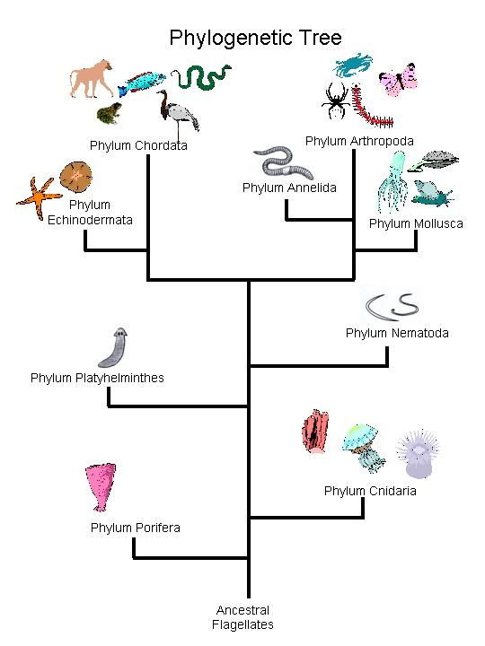
Phylogenetics = analysis of the evolutionary or ancestral relationship among different organisms.
A phylogenetic diagram displays how closely related a group of organisms are thought to be. (phylogenetic tree)

Slide 6
Cladistics
Cladistics uses shared, derived characters as the only criterion for grouping organisms.
Shared character = feature all members of a group have in common (hair in mammals)
Derived character = feature that evolved in within the group under consideration
Organisms that share one or more derived characters probably inherited those characters from a common ancestor.

Slide 7
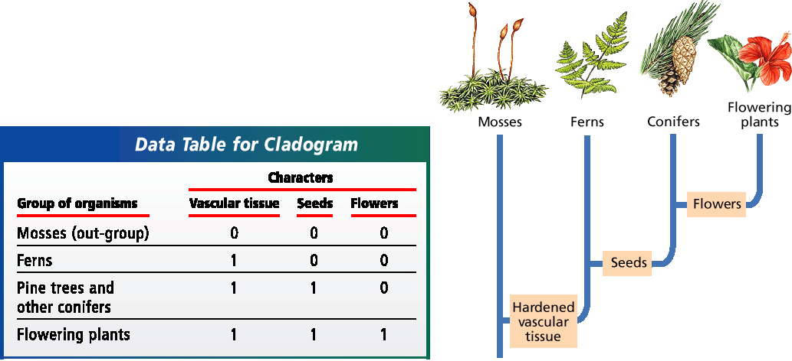
Clade = group of organisms that includes an ancestor plus all of its descendants.
Cladogram = phylogenetic diagram based on cladistics

Slide 8
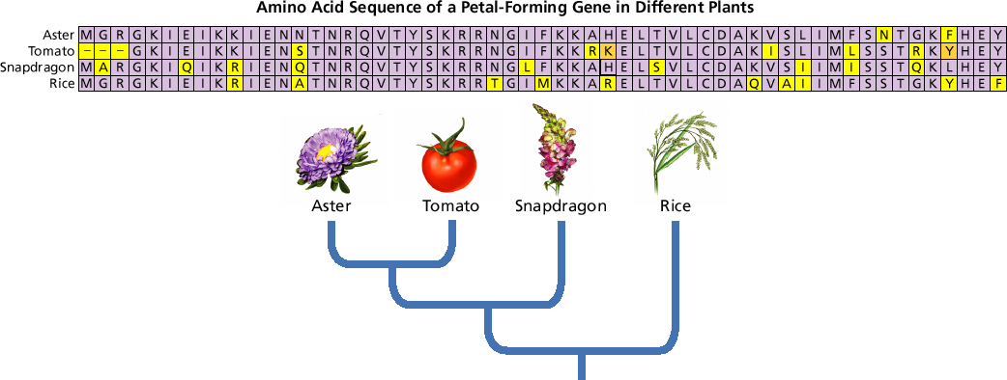
Molecular Cladistics
Molecular similarities (such as similar amino acid or nucleotide sequences), as well as chromosome comparisons, can help determine common ancestry.

Slide 9
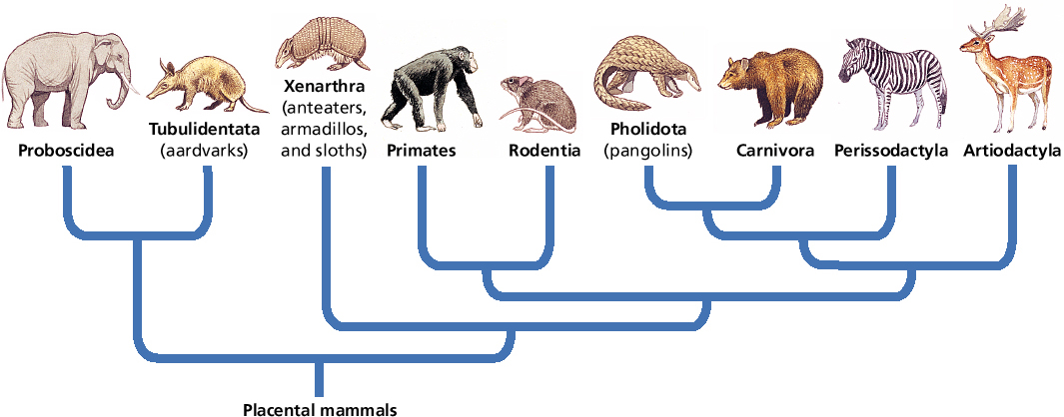
Phylogenetic Diagram of Mammals

Slide 10
Biodiversity and Taxonomy
Biologists have named and classified over 2 million species.
Only a fraction of the total number of species on Earth
thousands of new species discovered each year.
Biodiversity – the variety of organisms considered at all levels from populations to ecosystems.
Taxonomy is the science of describing, naming, and classifying organisms.

Slide 11
The Linnaean System
Carolus Linnaeus devised a seven-level hierarchical system for classifying organisms according to their form and structure.
From the most general to the most specific: kingdom, phylum, class, order, family, genus, and species.
Binomial Nomenclature
An important part of Linnaeus’s system was assigning each species a two-part scientific name—a genus name, such as Homo, and a species identifier, such as sapiens.
This system of a two-part name is known as binomial nomenclature.

Slide 12
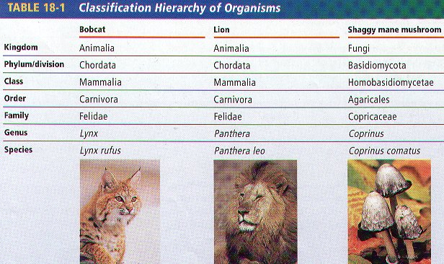

Slide 13
Identifying Organisms
One method used to help identify species is the use of a dichotomous key.
A dichotomous key uses pairs of contrasting, descriptive statements to lead to the identification of an organism.

Slide 14
