Slide 1
Plants
Chapters 27, 28, 29, 30, 31

Slide 2
Types of food plants
Agriculture- the growing of plants for human consumption
Cultivars- the growing of plants for specific traits
Cereals- grasses with grains for eating- esp. wheat and corn
Root corps- store carbs underground- esp. carrots and potatoes
Legumes- seeds form in pods- peas and soybeans
Fruits- part of a flowering plant that has seeds
Vegetables- leaves, stems, and roots of nonwoody plants
Nut- a hard, dry fruit
Herb- the leaf part used to add flavor
Spice- any other part of a plant used to add flavor

Slide 3
Plant uses
1. food
2. medicines
3. clothing
4. fabric dyes
5. fuel
6. rubber
7. perfume
8. cosmetics
9. housing
10. paper
11. furniture
12. pesticides

Slide 4
Plant problems
1. weeds
2. allergies
3. poisonous

Slide 5
Plant adaptations
1. cuticle- waxy coating to prevent water loss
2. physical defense- thorns
3. chemical defense- toxins

Slide 6
Plant reproduction
Two types
1. spore- haploid
2. seed- diploid

Slide 7
12 plant phyla
3 big categories
1. nonvascular- no inner tissues- 3 phyla and usu. Small
2. vascular and seedless- 4 phyla
3. vascular with seeds
  A. gymnosperms -4 phyla
  B. angiosperms – 1 phyla

Slide 8
Nonvascular plants
Aka bryophytes
Have 16,600 species
Primitive- no real root, stems, or leaves
Terrestrial
Like mosses, liverworts (used in digestive medicines), and hornworts (used in diarrhea and fever medicines)

Slide 9
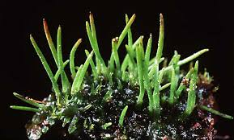
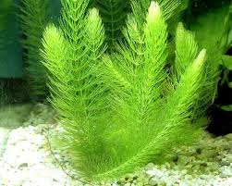
nonvascular
Liverwort
Hornwort

Slide 10
Vascular tissue
Tissue used to transport materials
1. phloem- carries organic compounds (food) and goes both directions
2. xylem- carries water and inorganics and only goes up

Slide 11
Vascular and seedless
3 called fern allies
1 called ferns
Produces cones with spores called strobilus

Slide 12
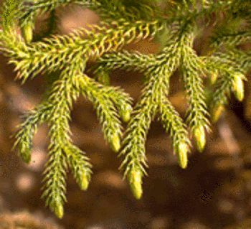
Fern allies
1. Microphylls- small leaves
2. spores come from base of leaves

Slide 13
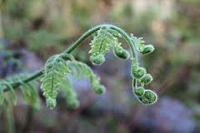
Ferns
1. fronds- big leaves (can coil or not)
2. spores from fronds
3. prothallia- intermediate fern generation
4. rhizomes- underground stems

Slide 14
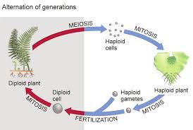
Fern reproduction
Both mitosis and meiosis

Slide 15
Vascular seeds
Gymnosperms
Angiosperms
Cones only
Have flowers
More diverse

Slide 16
Vascular tissue
Monocot
dicot
One cotyledon (seed leaf)
Parallel venation
Scattered vascular bundles
Flower petals usu occur in threes
Fibrous roots
Ex- wheat, corn, sugarcane, banana, grass
Two cotyledons
Net venation
Radially arranged vascular bundles
Flower petals usu occur in four or fives
One big taproot
ex:- peas, peanuts, tomatoes, oak trees

Slide 17
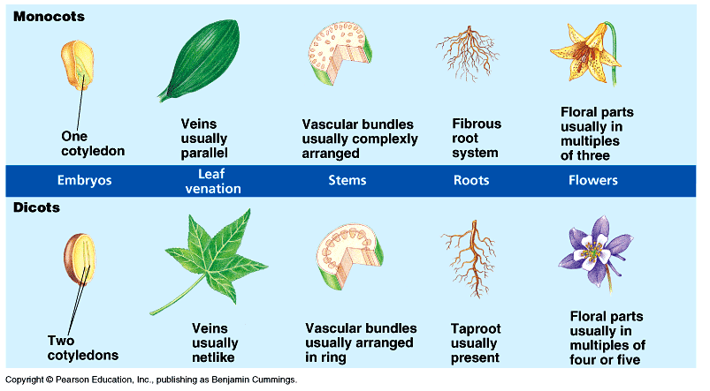
Monocot versus dicot

Slide 18
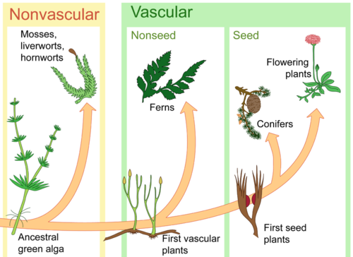
Plant evolution summary

Slide 19
3 types of plant cells
1. parenchyma- loose, cube-shaped, flexible in nonwoody plants for storing water and doing photosynthesis
2. collenchyma- thick, irregular shape and used for support
3. sclerencyma- thick, rigid cell walls for support, usu dead when used (in woody plants)

Slide 20
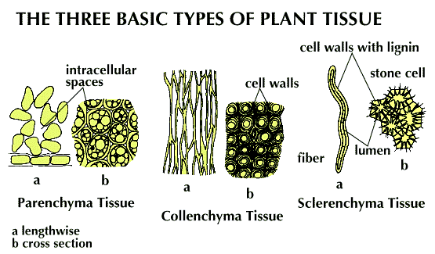

Slide 21
3 types of plant tissues
1. dermal- outermost layer used for protection and absorption
2. ground tissue- middle layer used for storage and support
3. vascular tissue- inner tubes for transport

Slide 22
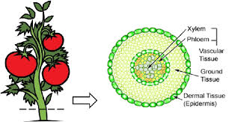
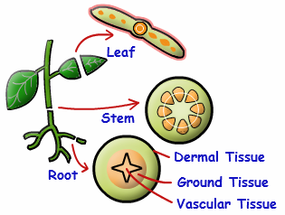

Slide 23
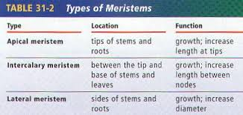

Slide 24
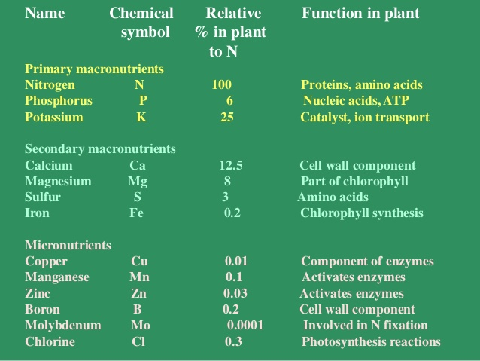

Slide 25
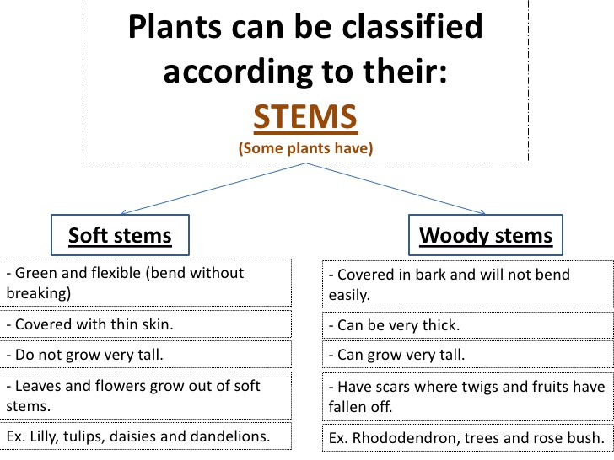

Slide 26
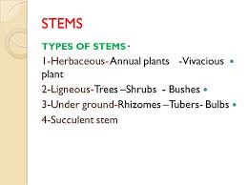

Slide 27
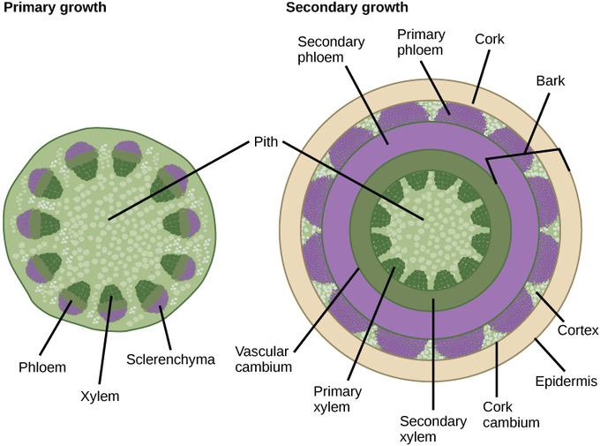
Stem growth

Slide 28
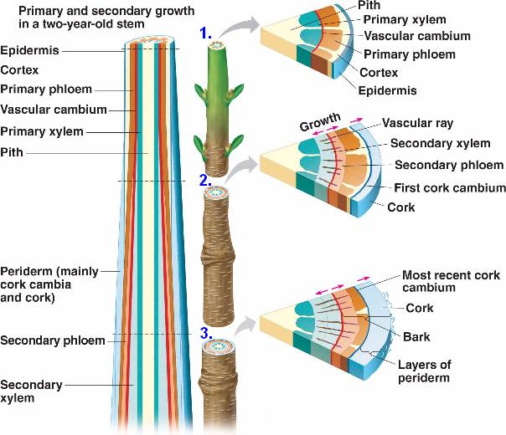

Slide 29
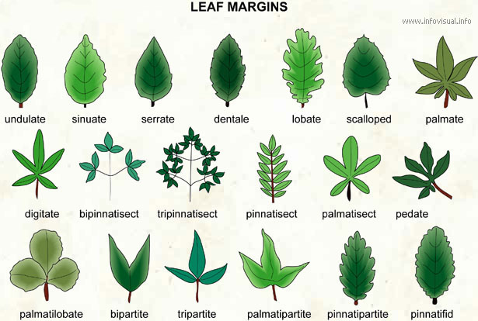

Slide 30
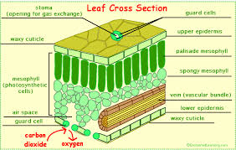
Petiole- where the leaf connects to the branch

Slide 31
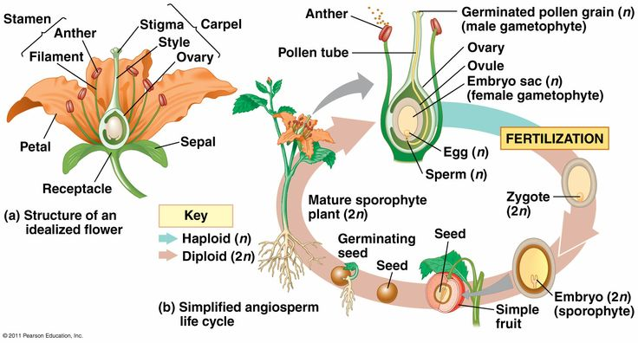

Slide 32
Fruits
A mature plant ovary enticing animals to eat it to spread the seeds inside it

Slide 33
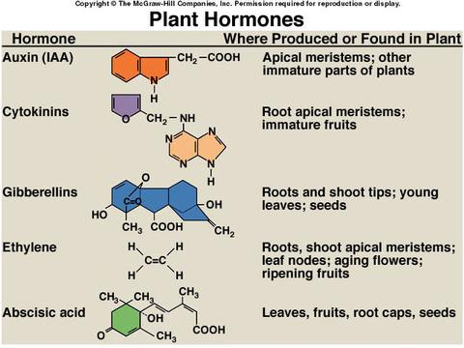

Slide 34
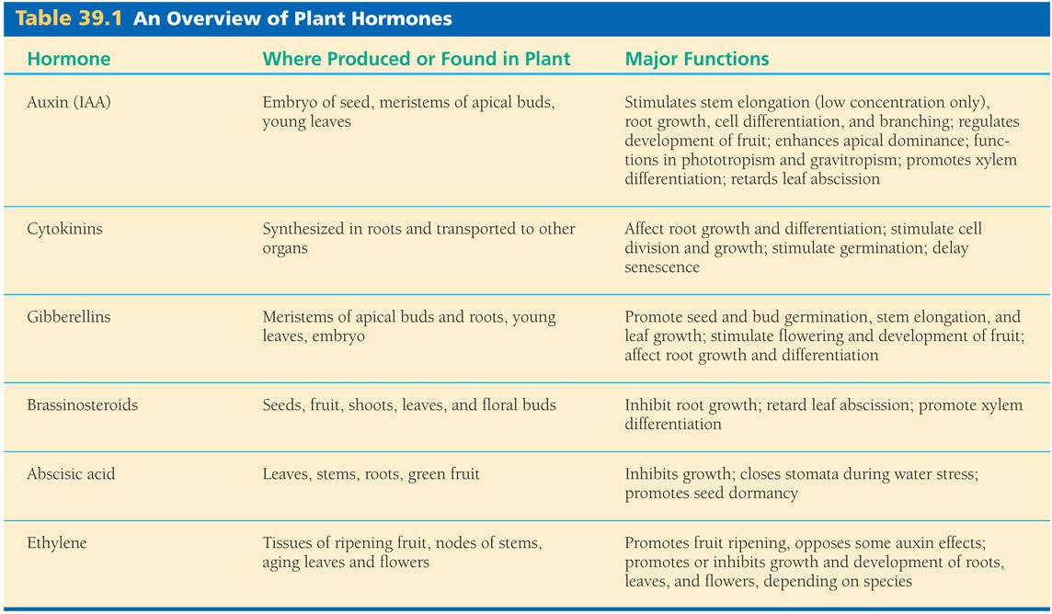

Slide 35
Plant movement
Stimulus called a tropism
Can be positive- toward something
Can be negative- away from something

Slide 36
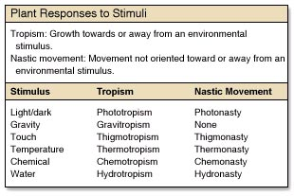

Slide 37
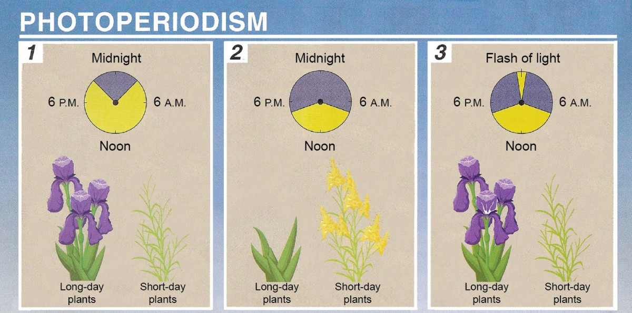
How to get the flowers to appear based on light exposure

