Slide 1
People of DNA
Chapter 10

Slide 2
Standards
CLE 3210.4.1 Investigate how genetic information is encoded in nucleic acids.
CLE 3210.4.2 Describe the relationships among genes, chromosomes, proteins, and hereditary traits
􀀹3210.4.1 Use models of DNA, RNA, and amino acids to explain replication and protein synthesis.
􀀹3210.4.5 Associate gene mutation with changes in a DNA molecule.
SPI 3210.4.1 Identify the structure and function of DNA.
SPI 3210.4.2 Associate the process of DNA replication with its biological significance.
SPI 3210.4.3 Recognize the interactions between DNA and RNA during protein synthesis.

Slide 3
Objectives
1. know the 5 main experiments that discovered DNA and the people
2. know the parts of DNA and RNA
3. know the differences between DNA and RNA
4. know which bases match up and how many bonds
5. know the direction of DNA
6. know how DNA replicates
7. know the central dogma
8. know the difference between point, genetic, and chromosomal mutations
9. know the types of each mutation
10. know the enzymes used in replication

Slide 5
Friedrich Miescher
1869
Discovers something called DNA, not sure what it does
By accident while studying proteins
We care because it is our genetic code

Slide 6
Albrecht Kossel
1878
Discovered the five nucleobases
A, T, C, G, and U
Today have a sixth I, hypoxanthine

Slide 8
Phoebus Levine
1919
Discovered the nucleotide- sugar, base, and phosphate
DNA- deoxyribonucleic acid
RNA-ribonucleic acid
We care because these three men gave us all the parts of DNA

Slide 10
Frederick Griffith
1928
Looked at Streptococcus pneumoniae
Studied virulence- disease-causing strains
R strains did nothing
S strains killed mice
S + R still killed the mice
Killed a bunch of mice
We care because proved transformation- something transferring genetic material

Slide 12
Oswald Avery, Colin MacLeod, and Maclyn McCarty
1944
Used proteins to prove what was causing the transferrence
Used Protease on proteins
Used RNase on RNA
Used DNase on DNA
Three batches, only the DNase experiment had live mice
Killed lots more mice
We care because it proved DNA was responsible for transformation

Slide 14
Erwin Chargaff
1950
Discovered 3 base pairing rules, which ones go together
Discovered complementary base pairs- how they are matched
Purines (A & G) and pyrimidines (T & C & U)
Matched A=T= U with two hydrogen bonds
Matched C=G with three hydrogen bonds
We care because that determined the size of DNA’s width

Slide 16
Alfred Hershey and Martha Chase
1952
Used bacteriophages- bacterial viruses (makes bacteria sick)
Used radioactive isotopes ³⁵S on protein and ³²P on DNA
Used E. coli to see which part went in the cell via a blender and centrifuge
We care because proved DNA is the hereditary material

Slide 18
Rosalind Franklin
1952
Took THE photo 51, with Raymond Gosling
Used X-ray crystallography
Used by Watson and Crick to determine shape of DNA
First picture by William Astbury in 1937

Slide 20
Photo 51
Has regular pattern
Distinct X
Consistent dimensions – measured the width to be 3.3 Angstrom’s long (0.33 nm)
We care because that describes a double helix- shape of DNA

Slide 21
DNA double helix twists have two sizes

Slide 22
Maurice Wilkins
1952
Franklin’s supervisor
Showed her photo to Crick (competitor)
We care because that lead to the discovery of DNA shape

Slide 23
Linus Pauling
1953
Watson and Crick’s rival
Said DNA was a triple helix with sugar-phosphate on the inside
Was wrong
We care because it cut down Watson and Crick’s discovery time

Slide 25
Francis Crick and James Watson
1953
Discover the shape of DNA
Alpha double helix with the bases on the inside and the phosphate sugar backbone on the outside
We care because it is our genetic information

Slide 27
Crick, Watson, and Wilkins
1962
Get the Nobel Prize in Medicine for discovering DNA

Slide 28
Three functions of DNA model
1. genetic information
2. built in timers so cells cannot live forever
3. how traits get passed from parent to offspring

Slide 29
Francis Crick
Later discovered the codon- set of three bases to make one amino acid
Also discovered central dogma of replication
Amino acids tell how to build proteins
We care because now we can have molecular genetics as a field of study to cure diseases

Slide 30
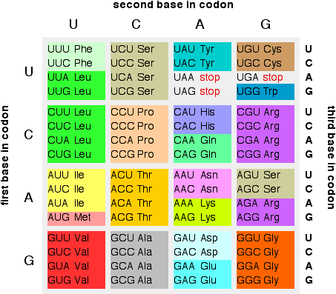

Slide 31
Codon charts
Codon chart
Codon wheel

Slide 32
Reading codons
Use the mRNA to read
Start- AUG or methionine
End- UAG, UAA, AND UGA – NO AMINO ACID CREATED
64 combinations- so some repeat- that is called degeneration

Slide 33
Matthew Meselson and Franklin Stahl
1958
Used an isotope of ¹⁵N to discover how DNA replicated
Replicates semi-conservatively
Means one half of the original found in the new strand
Because the strands are complimentary- each is the opposite of the other- each side is used to make two identical new strands

Slide 35
Human DNA
Base sequence- order of the bases
Genome- all the genes – human one completed Feb 2001
Led to bioinformatics- compares DNA sequences
Roughly 3.2 billion base pairs
Roughly 3 meters long, end to end
Roughly 30,000 genes
Runs 5’ to 3’ end
Has an overall negative charge

Slide 36
Central dogma
Theory of DNA replication and production of proteins
DNA is transcripted into RNA
RNA is translated into proteins

Slide 38
Replication enzymes
Helicase unwinds DNA
DNA polymerase add complementary nucleotides found in the nucleus
Ligase tapes DNA together
Other polymerases and exonucleases proofread to make sure pairing correctly

Slide 39
DNA structure 5’ to 3’ makes antiparallel

Slide 40
Can only be replicated in the 5’ to 3’ direction
Double strands run antiparallel to keep phosphate and sugars on the outside and bases on the inside
Has a leading and lagging strand in Okazaki fragment
Leading is continuous
Lagging is in chunks
Covalent bonds between sugar and phosphates
Hydrogen bonds between bases

Slide 42
Replication errors
One error for every billion base pairs
Mutation- any change in the DNA
If alters the protein, cannot do its job, lots of trouble
Can be good or bad
Bad ones can lead to cancer

Slide 43
Point mutation
One base pair gets changed
3 types
1. point (switch)
2. insertion
3. deletion

Slide 44
THE FAT CAT ATE THE RAT
THE FAT BAT ATE THE RAT
POINT MUTATION

Slide 45
THE FAT CAT ATE THE RAT
THE CFA TCA TAT ETH ERA T
INSERTION

Slide 46
THE FAT CAT ATE THE RAT
THE FAT ATA TET HER AT
DELETION
Also known as a frame shift mutation when whole codon grouping is changed

Slide 47
Chromosomal mutation
Change in the number or structure of the chromosome
Deletion-part of the chromosome is lost
Duplication-extra part of chromosome is added
Inversion-order of the genes on the chromosome is changed
Crossing over
Nondisjunction

Slide 48
Nucleo- word review
1. nucleoid
2. nucleus
3. nucleolus
4. nuclear envelope
5. nucleosome
6. nucleic acid
7. nucleotide
8. nucleoside

Slide 49
DNA wrapping so it all fits in the nucleus

Slide 50
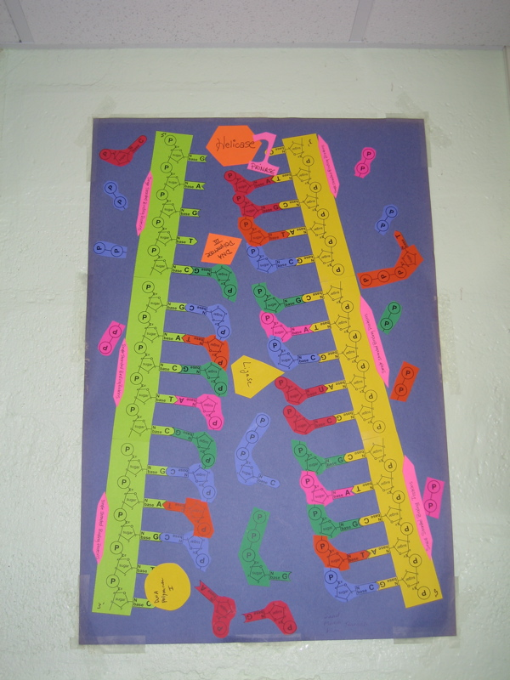
Your final product should look something like this!

