Slide 1
Mitosis

Slide 2
Standards
CLE 3210.1.4 Describe the processes of cell growth and reproduction.
􀀹3210.1.6 Demonstrate the movement of chromosomes during mitosis in plant and animal cells.
SPI 3210.1.6 Determine the relationship between cell growth and cell reproduction.

Slide 3
Objectives
Explain ploidy
What ploidy do humans have
Explain mitosis
List the three reasons for mitosis
Define cell cycle
Define genetic screening-why is it used
List the stages of mitosis and meiosis
How many cells does each produce
Explain the two types of human cells
Explain the two types of chromosomes
Draw a chromosome and label all the parts
Give two examples of cyclins
How many chromosomes do humans have
What are cell plates used for
What are the parts of interphase

Slide 4
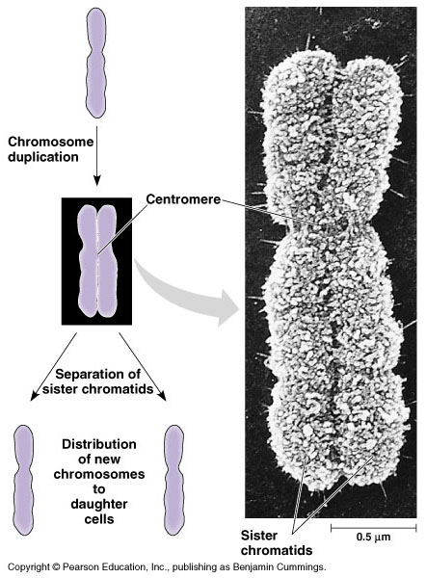
Chromosome
And chromatids

Slide 5
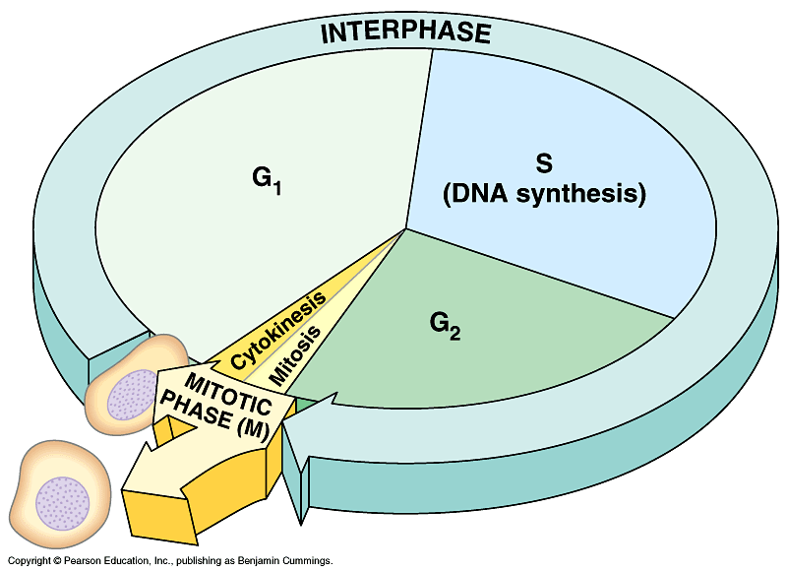

Slide 6
Wrapping of chromosomes

Slide 7
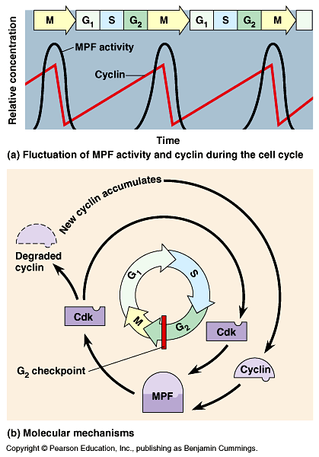
checkpoints

Slide 8
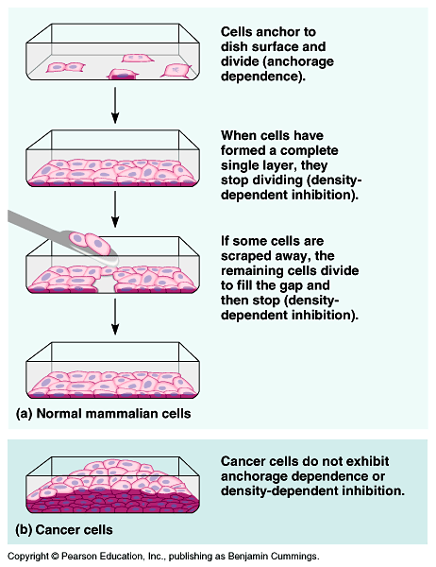
Normal cells
Versus
Cancer cells

Slide 9
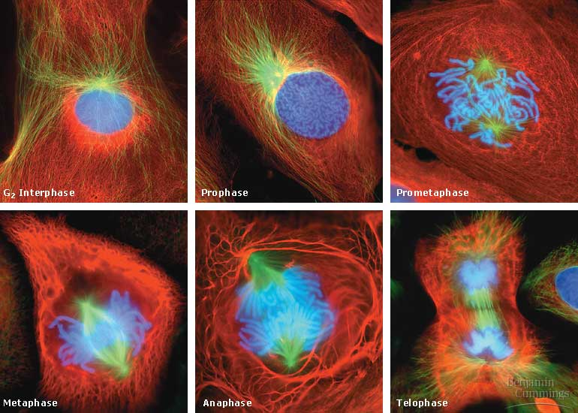
Cell Division

Slide 10
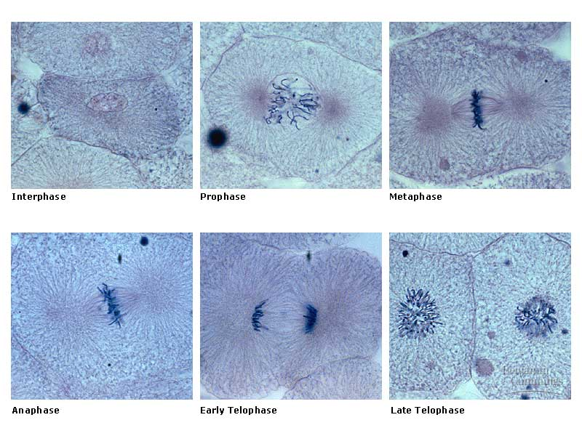
Animal Cell - Mitosis

Slide 11
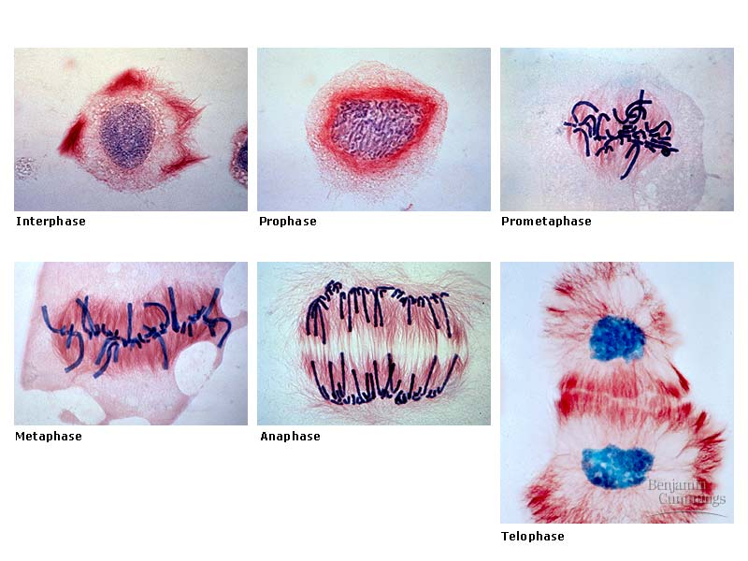
Plant Cell - Mitosis

Slide 12
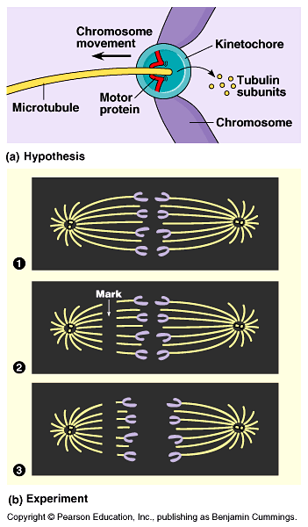
Anaphase
Interrupted

Slide 13
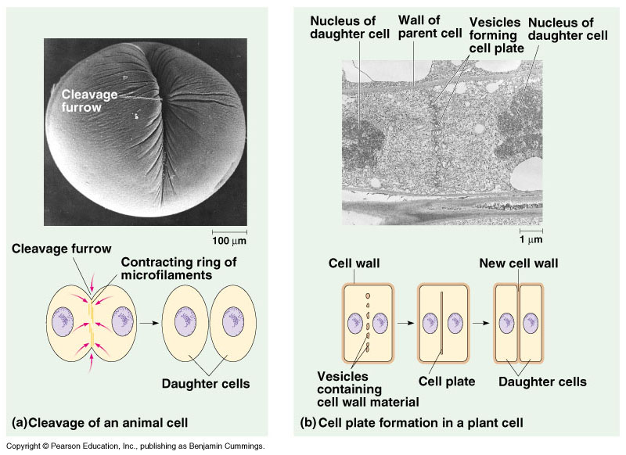
Cytokinesis

