Slide 1
meiosis

Slide 2
Standards
CLE 3210.4.5 Recognize how meiosis and sexual reproduction contribute to genetic variation in a population.
SPI 3210.4.6 Describe how meiosis is involved in the production of egg and sperm cells.
SPI 3210.4.7 Describe how meiosis and sexual reproduction contribute to genetic variation in a population.

Slide 3
Objectives
Define crossing over
Define nondisjunction
Define independent assortment
Where do polar bodies come from
What are the stages
How many cells versus chromosomes are there
Genetic diversity

Slide 4
Life Cycle - if Meiosis
Female 46 Male 46
egg 23 sperm 23
Zygote 46
mitosis mitosis
Meiosis

Slide 5
Stages Of Meiosis: Meiosis I
Mother cell
Interphase
Prophase I:
Condensing Chromosomes
Prophase I:
Tetrad formation/
crossing over
Metaphase I
Meiosis II
Anaphase I
Telophase I

Slide 6
Stages Of Meiosis: Meiosis II
Telophase I
The products of meiosis are 4 haploid cells each with a unique set of chromosomes.
Prophase II
Metaphase II
The products of mitosis are 2 diploid cells with identical chromosomes.
Anaphase II
Telophase II

Slide 7
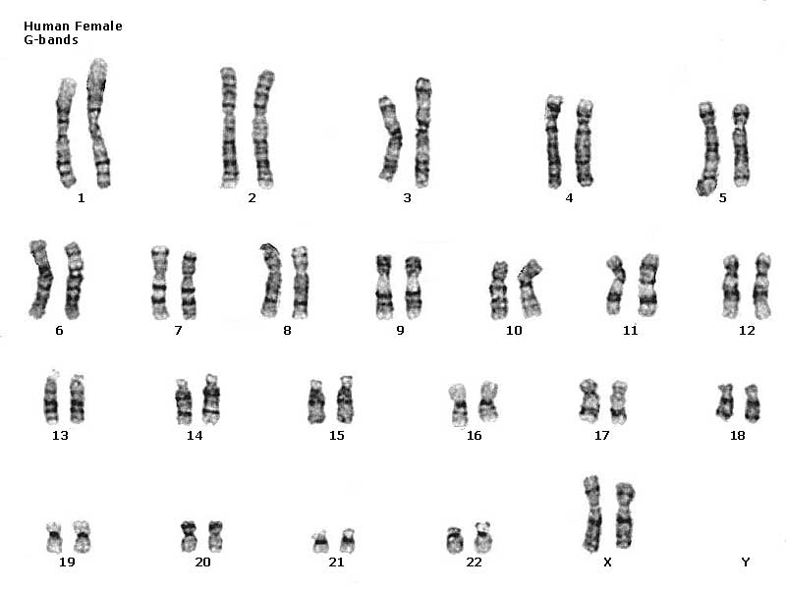
Homologous
Chromosomes

Slide 8
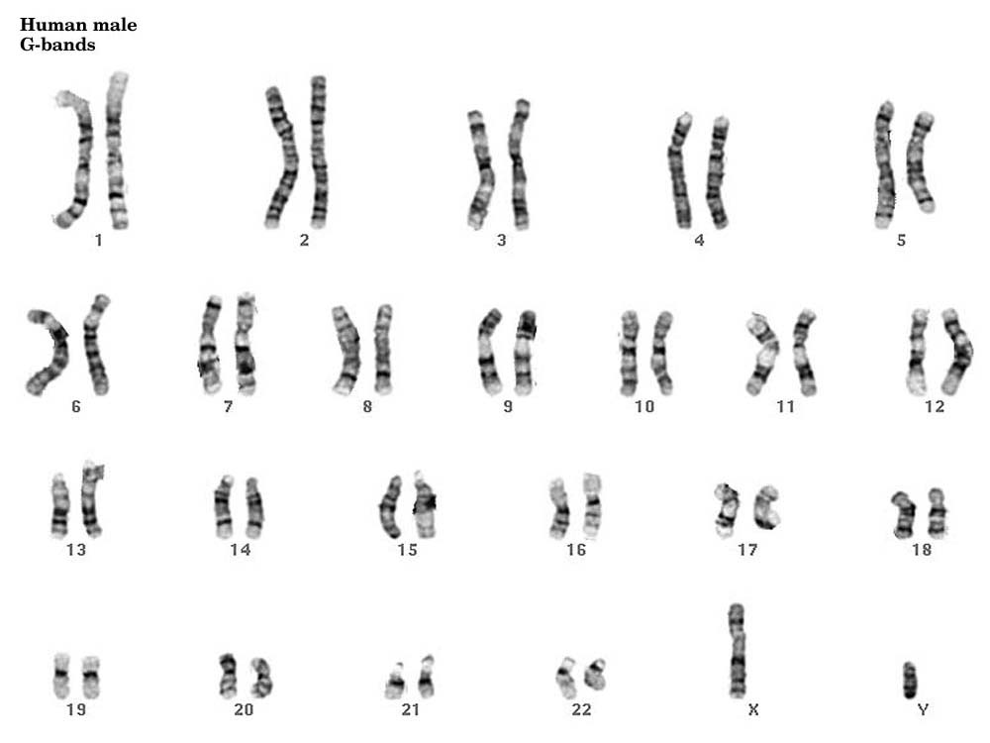
Homologous chromosomes

Slide 9
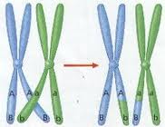
Crossing-Over

Slide 10
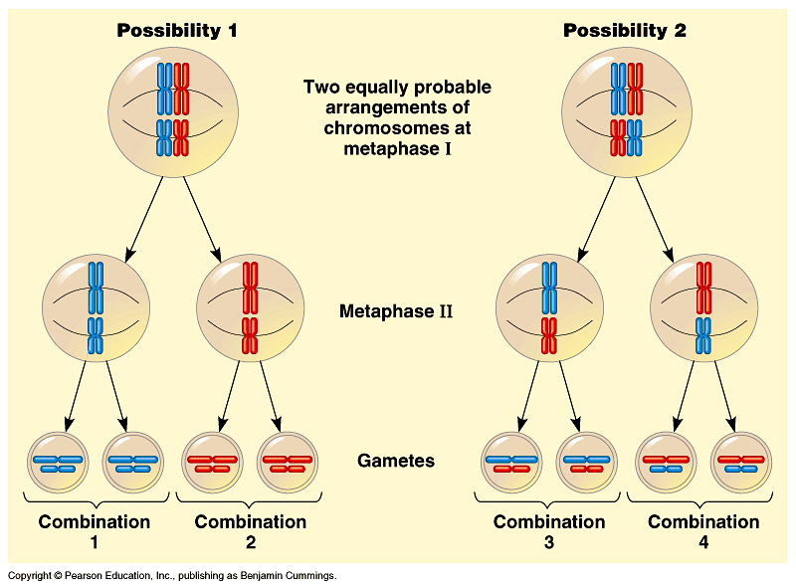
Independent
assortment

Slide 11
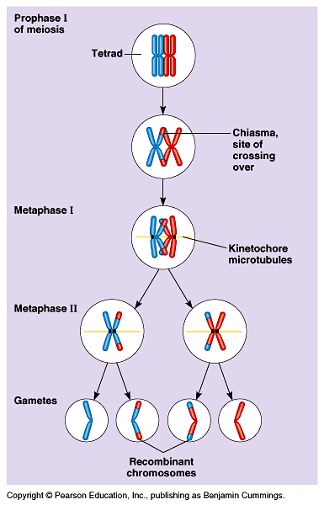
Crossing over increases
Genetic diversity

Slide 12
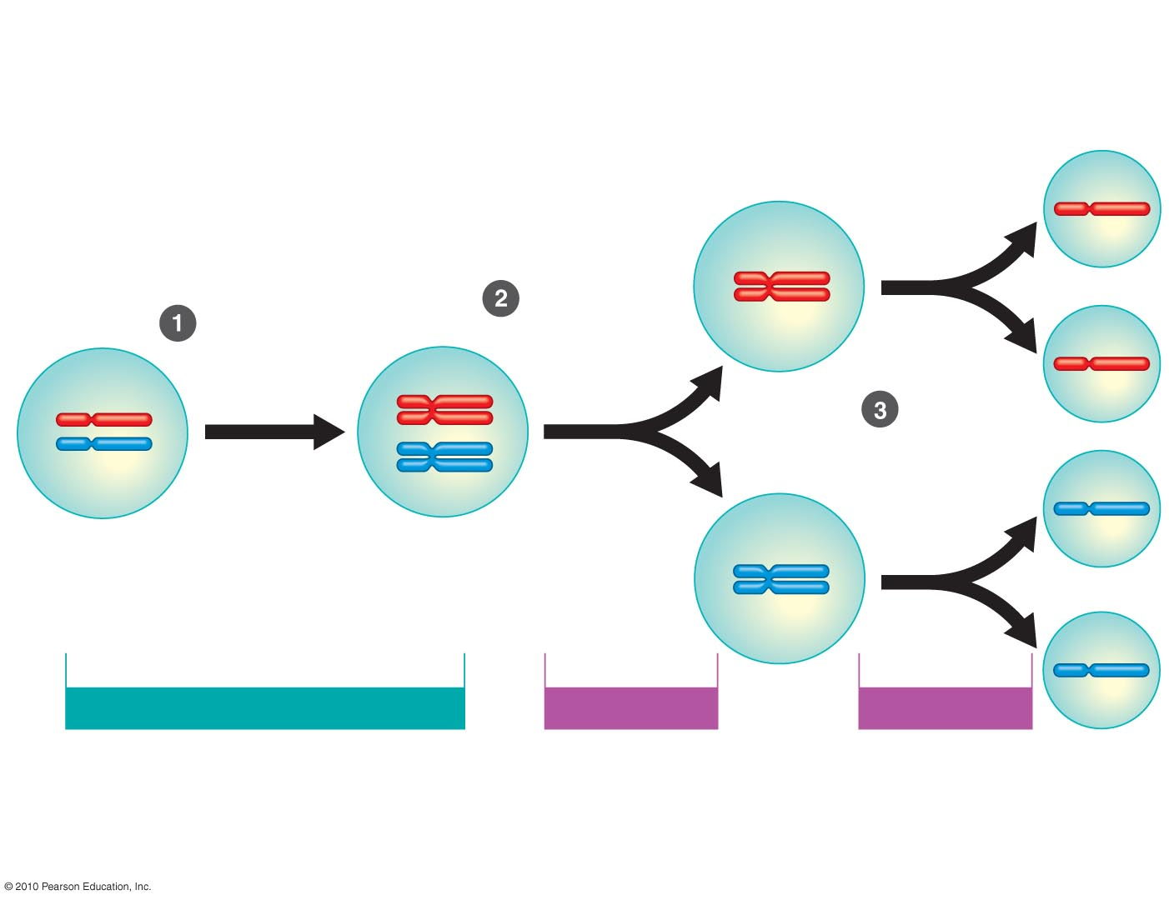
Homologous
chromosomes
separate.
Chromosomes
duplicate.
Sister
chromatids
separate.
Pair of homologous
chromosomes in
diploid parent cell
Duplicated pair of
homologous
chromosomes
Sister
chromatids
INTERPHASE BEFORE MEIOSIS
MEIOSIS I
MEIOSIS II
Figure 8.13-3
Notes:
12
Figure 8.13 How meiosis halves chromosome number. (Step 3)

Slide 13
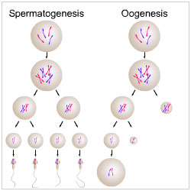

Slide 14
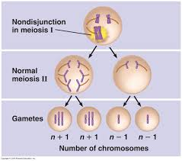
nondisjunction

Slide 15
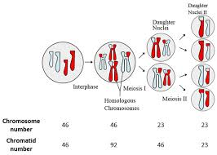
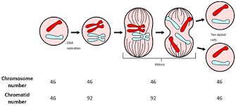
Mitosis
Meiosis

