Slide 1
Intro

Slide 2
Scientific Method
1. Observation
1b. Inference- a guess or opinion
2. Hypothesis
3. Experiment
4. Data
5. Conclusion/Results
6. Theory

Slide 3
SI Units
Physical quantities- what is being measured
Units- what type it is
Quantitative-quantity or the numbers or how much
Qualitative- quality or the description or how good

Slide 4
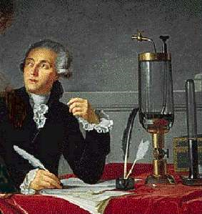
ANTOINE LAVOISIER
Late 1700s, France
Designed a balance that could measure
to the nearest 0.0005 g
Helped transform chemistry from a
science of observation to a science of
measurement!

Slide 5
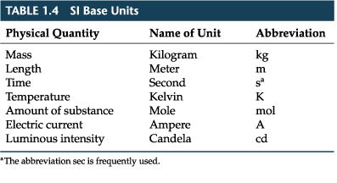
SI Units- 7 quantities (can stand alone)

Slide 6
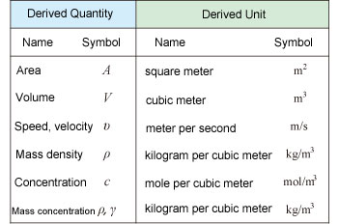
SI Units- 6 derived quantities ( found mathematically)

Slide 7
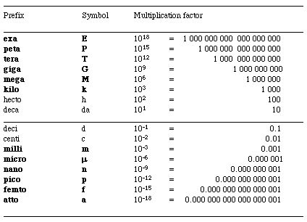
SI Units- prefixes

Slide 8
Variables
Independent (aka the manipulated variable)- what is being measured
Dependent- the part that shows the change
Control- nothing was changed, added or taken away. The way to prove something would not have happened anyway. Sometimes called a placebo in medicine.

Slide 9
Graphs
Title
Label- name and units
X-axis= independent variable
Y-axis= dependent variable

Slide 10
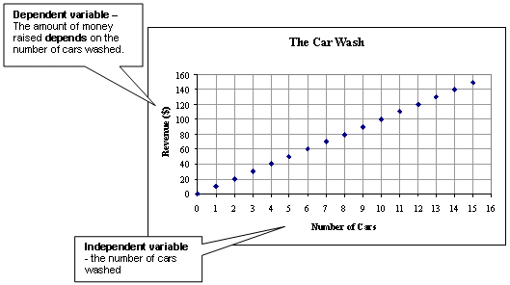
Graphs

