Slide 1
Human Evolution

Slide 2
Divergent evolution- starts the same, then the differences add up

Slide 3
Divergent evolution in butterflies

Slide 4
Divergent evolution in butterflies

Slide 5
Human Taxonomy
Starts general, ends specific
Domain Eukarya
Kingdom Animalia
Phylum Chordata
Class Mammalia
Order Primate
Family Hominidae
Genus Homo
Species sapiens

Slide 6
Vocab
Homonid- all ancestors, including apes
Homonin- only human ancestors

Slide 7
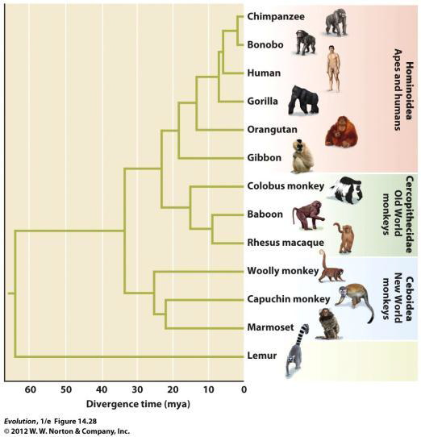
Phylogeny of Primates
• Humans diverged from Chimpanzees ~5.5 mya
• (Humans & Chimps shared a Last Common Ancestor that existed ~5.5 mya)

Slide 8
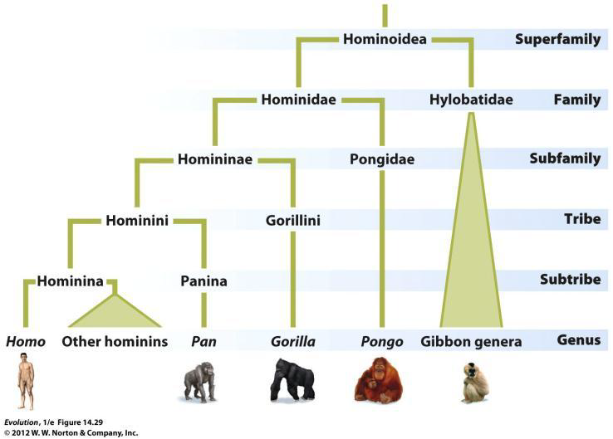
Nomenclature (look at the suffix)

Slide 9
Overview of Hominin Evolution
progression is not linear
• during much of hominin evolution, multiple species coexisted
• most species are now extinct
• Homo sapiens sole representatives <30,000 years

Slide 10
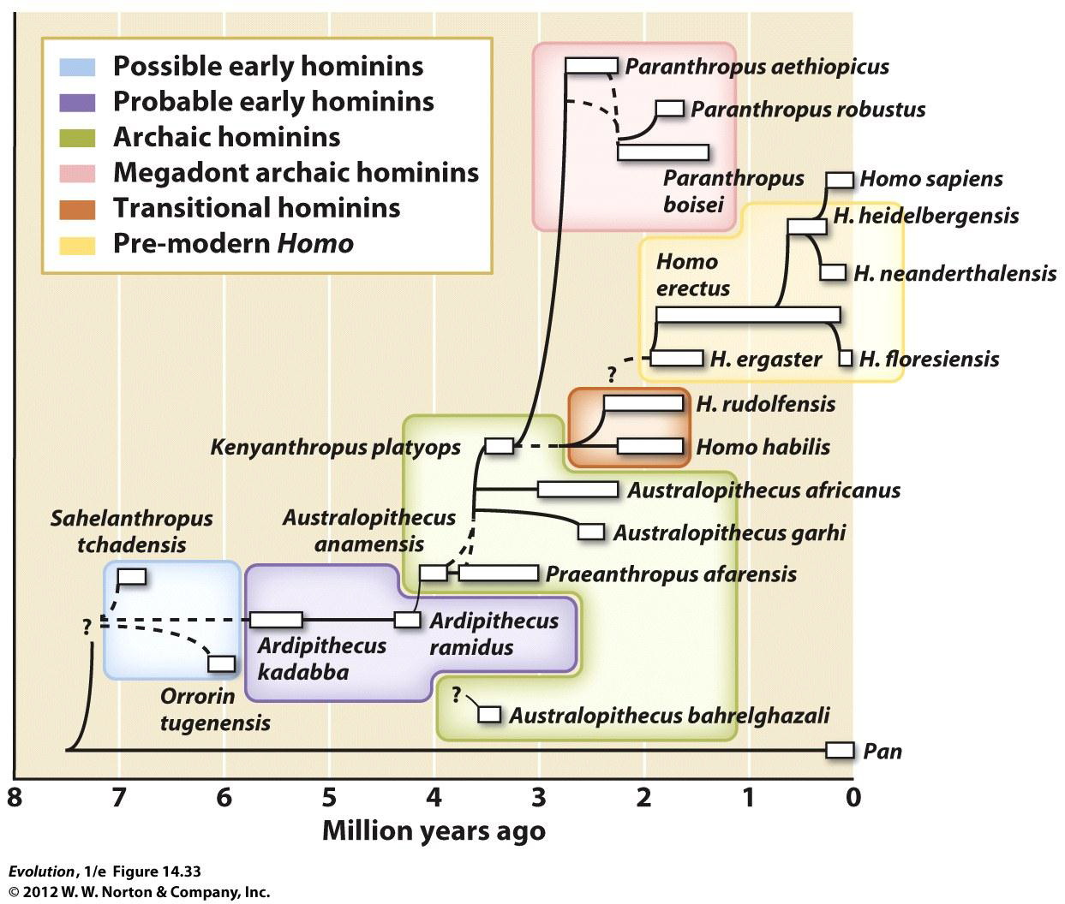

Slide 11
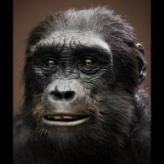
Possible Early Hominin
• Near the human/chimp split, close to the LCA
• Mixture of traits (small brain like a chimp, but flat face like more recent human ancestors)

Slide 13
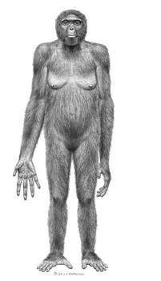
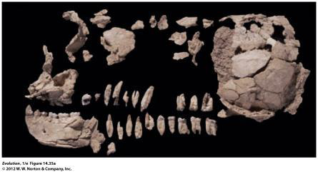
Ardipthecus ramidus “Ardi”
Age ~4.4 mya, near LCA of human/chimps
Small brain (300 – 350 cm2)
Lived in wooded environment, probable omnivores

Slide 14
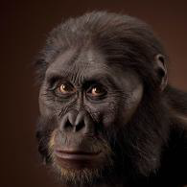
Australopithecus afarensis “Lucy”
~4 – 2.5 mya
Relatively small brains (400-500 cm2)
Height of ~3’7”-4’11”
Lifespan, 18-23 years
“regularly” walked upright
transition from trees to ground
change in exposure to parasites
zoonotic infections (anthrax, roundworm, tapeworms, etc)

Slide 15
History
Louis and Mary Leakey worked in Kenya in the 1920-1950s to find hominin fossils found the H. habilis

Slide 16
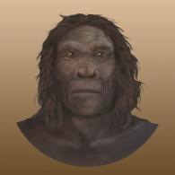
Homo habilis “Handy man”
~2.5 – 1.5 mya
Slightly larger brains (510-775 cm2)
Undisputed use of tools (scrapers, “choppers”)
Scavenger & hunter
Speculate 50-60 individuals in a group (area ~200-600 square miles)
Hypothesized to inhabit crude rock shelters

Slide 17
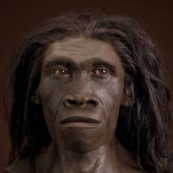
Homo erectus
2 mya – 140,000 ya
Larger brains (~850 cm3)
Specific adaptations to life on the ground (e.g., elongated legs, shorter arms)
Close to modern human body size
Beginnings of society (lived in caves, cared for old & weak)

Slide 18
Homo erectus
First hominin species to leave Africa (“long journey” hypothesis)
Highly variable & long-lived species (9x longer than H. sapiens)
Coexisted with other Homo species, including H. sapiens
Had Parasites
Vector transmitted diseases stayed in Africa (filariasis, blood fluke, sleeping sickness)
New environments w/new animals = new sources of parasites
More sophisticated tools & increases in human cooperation allowed hunting, & larger population sizes

Slide 19
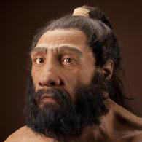
H. neanderthalensis
200,000 – 28,000 ya
Very large brains (~1000-2000 cm3)
Bodies are shorter and more stocky than modern humans (adapted to Northern climates)
Used diverse set of tools, fire, lived in shelters, wore clothing, hunted large animals, made ornamental objects, buried dead (?)
Overlapped with H. sapiens briefly (30,000 – 50,000 years); H. sapiens likely had more sophisticated weapons

Slide 20
What do you think? Is this progression probable?

Slide 21
Homo sapiens
Originated in Africa ~200,000 ya & spread throughout Europe and Asia ~100,000 ya
Large brains, ~1300 cm3
Lighter skeletons, smaller teeth
Complex brain allowed development of structured social interactions
Over course of history transitioned from hunter-gatherers to agriculture (~12,000 years)

Slide 22
Homo sapiens
More people meant more disease
8000 BC ~0.2 people/square mile
4000 BC 4 people/square mile
Cultural revolution = tool-making
Agricultural revolution
Industrial (Scientific) revolution

Slide 23
What do you think? Why is Homo sapiens the hominin with the most epidemics and diseases?

Slide 24
Carrying Capacity
1)External factors
availability/types of food (vegetarian vs meat?)
space
2)Internal factors
lower birth rate (nomadic vs. sedentary)
infanticide
virulence

Slide 25
Effects of civilization
More sedentary life-live in one area
Irrigation spread contaminated water
Agriculture gave close quarters with animals-zoonotic parasites
Cities had waste problems with “night soil”
Trade and commerce routes spread epidemics
Migration & climate change lead to new ecological niches (& exposure to parasites)
Development of tools which lead to change in diet and social structure
Increase in population density (ease of transmission & increase in virulence in diseases)

Slide 26
Immunity
1. Innate- born with- skin, mucous, fever
2. Acquired- something you get- antibodies, vaccines

Slide 27
Major epidemics
Smallpox- killed pharaohs 1580 BC
Cholera- bacteria that causes dehydration by diarrhea
Malaria- climate change extending mosquito habitat
Bubonic plague-killed 1/3 of Europe
Influenza- has killed 20 million people
Parasites

Slide 28
What do you think? How have these epidemics affected the evolution of hominids/hominins?

Slide 29
What do you think? Are epidemics and diseases a form of population control? Should we continue to use medicines at the risk of making resistant pathogens?

Slide 30
Thank you Dr. Simon

