Slide 1
Gene Expression

Slide 2
Vocab
Genome- the complete genetic material contained in an individual
Gene expression- the activation, or “turning on” of a gene that results in transcription and the production of mRNA

Slide 3
Pro v Eu
Prokaryotes- have operons and cytoplasm is site of transcription and translation
Regulation based on transcription
Eukaryotes- have introns and exons, transcription is in the nucleus, translation is in the cytoplasm
Regulatory proteins are transcription factors
Enhancers- far from the promoter, where the transcription factors bind

Slide 4
Prokaryotes
Escherichia coli
Bacterium
Studied by Francois Jacob and Jacqes Monod in the early 1960s
Discovered how genes control the metabolism of the sugar lactose

Slide 5
DNA segments
Structural genes- DNA segment of genes that code for polypeptides
Promoter- DNA segment that is recognized by RNA polymerase to initiate transcription
Operator- DNA segment that controls the access of RNA polymerase to move along the structural genes
All three combined make an operon- series of genes that controls the products (polypeptides) and the regulatory enzymes of the genes

Slide 6
2 types of Operons
Repressor-protein that inhibits genes from being expressed when attached to the operator
Coded for by regulator genes
Inducers- a molecule that binds to the repressor, releasing it from the operator, and induces transcription to begin

Slide 7
Lac operon
Prokaryotic example- lac operon- structural genes code of the enzymes that control lactose metabolism
When lactose was absent, the enzymes were not expressed because a repressor protein was attached to the operator
When lactose is present, the enzymes were expressed because it binds to the repressor and removes it from the operator allowing transcription
Here lactose acts as the inducer

Slide 8
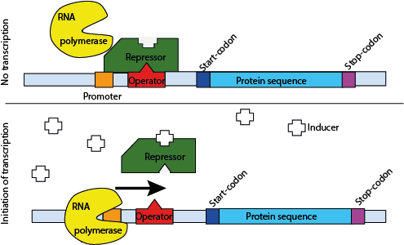

Slide 9
Eukaryotes
Euchromatin- uncoiled section of DNA that allows transcription
After the promoter, have the introns and exons
Introns- transcribed but not translated, the ones that get cut out
Exons- get transcribed and translated
Because transcription is in the nucleus and translation is in the cytoplasm, the physical separation of the nuclear envelope allows more chances to control gene expression

Slide 10
Pre-mRNA
Introns and exons can be used to describe both DNA and RNA that are transcribed
Pre-mRNA contains a form of messenger RNA that has the introns and exons
Spliceosomes and snurps, snRNPs- small nuclear ribonuclearproteins, cut out the introns to make mRNA
Now we have a ribosomal enzyme that is not a protein
It is made of RNA and called ribozyme

Slide 11
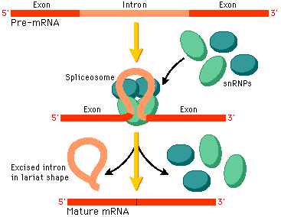

Slide 12
Pro and Eu
Both can turn on and off different genes based on what the cell needs
Only some genes are used in each cell at a time
Allows cell differentiation- specialization of cells
Made with homeotic genes- regulatory genes the determine where specific structures go

Slide 13
Drosophila
Homeobox- DNA sequence the codes for proteins to regulate patterns of development
Scientists can move these in fruit flies to watch what happens
Homeoboxes can be deleted, substituted, translocated (moved else where), and copied producing different phenotypes than normal

Slide 14
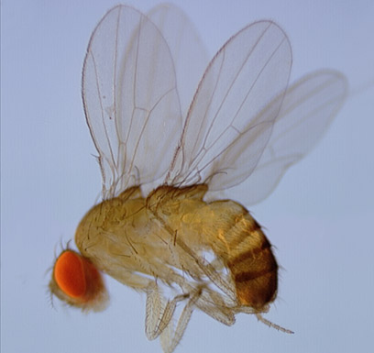
Homeobox copied and put in creates three sets of wings instead of the normal one set

Slide 15
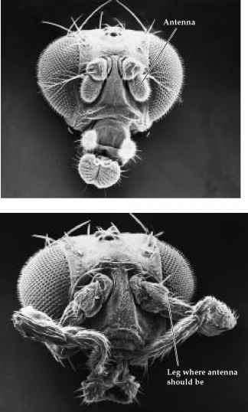
Translocated homeobox got placed somewhere else, so legs are grown from the fly’s face

Slide 16
Regulators
Proto-oncogenes- regulate cell growth, division, and adherence of cells to each other
Oncogene- gene that can cause uncontrolled cell division
Tumor-suppressor genes- code for proteins to prevent cell division from occurring too often

Slide 17
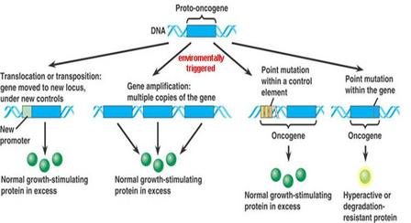

Slide 18
Cancer
Tumor- tumor-suppressor genes were damaged and cell divide uncontrolled
Density-dependent regulations are inhibited- usually stop dividing at 40 rounds or if too dense
Cancer keeps dividing because too many mutations in the DNA sequence of proto-oncogenes and tumor-suppressor genes
Metastasis- when the cancer cells start growing beyond the original site

Slide 19
Carcinogens
Substance that can induce or promote cancer
Mutagens- cause mutations in cells
Examples: tobacco smoke, asbestos, too much X-ray or UV radiation, too much sunlight, some viruses- especially in blood-forming tissues

Slide 20
Types of cancer
Carcinomas- tumors in the skin and body organs
Sarcomas- tumors in bone and muscle
Lymphomas- tumors in the lymphatic system
Leukemia- tumors in blood-forming tissues

Slide 21
Cancer risks
Carcinogen exposure
Not wearing PPE in science classes
Genetic predisposition
Some viruses- some viruses are oncogenes or cause mutations in proto-oncogenes to increase cell production to create more virus particles

Slide 22
DNA research timeline
1990- start of Human Genome Project
1997- Dolly, first sheep clone born
2002- mouse genome finished
2003- human genome finished
2004- Koreans clone human embryos

