Slide 1
Evolution
Ch 16

Slide 2
standards
SPI 3210.5.3 Recognize the relationships among environmental change, genetic variation, natural selection, and the emergence of a new species.
SPI 3210.5.4 Describe the relationship between the amount of biodiversity and the ability of a population to adapt to a changing environment.
SPI 3210.5.5 Apply evidence from the fossil record, comparative anatomy, amino acid sequences, and DNA structure that support modern classification systems.

Slide 3
objectives
1. differentiate between types of evolution
2. explain the ways evolution can happen
3. calculate the Hardy-Weinberg allele frequency of a population
4. three types of natural selection
5. types of speciation
6. define species

Slide 4
Types of evolution
Convergent- the process by which species evolve similar traits from different ancestors, mechanism for analogous structures
Divergent- the process by which species evolve different traits from common ancestors, mechanism for homologous structures
Parallel- two species already diverged, but evolve similar traits
Adaptive radiation- new population fills in new environment from common ancestor in specific area, no migration
Coevolution- two or more species evolve adaptations to each other’s influence, esp. in arms wars
Artificial selection- when humans interfere

Slide 5
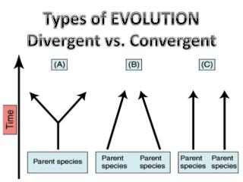

Slide 6
Artificial selection
Humans interfere
Originally pugs had noses, got selected against for other traits like being a good companion
https://dogbehaviorscience.wordpress.com/2012/09/29/100-years-of-breed-improvement/

Slide 7
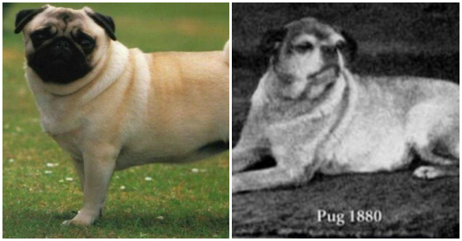

Slide 8
Speciation
The formation of a new species
Species- members of a population that can interbreed
Created by gradualism or punctuated equilibrium

Slide 9
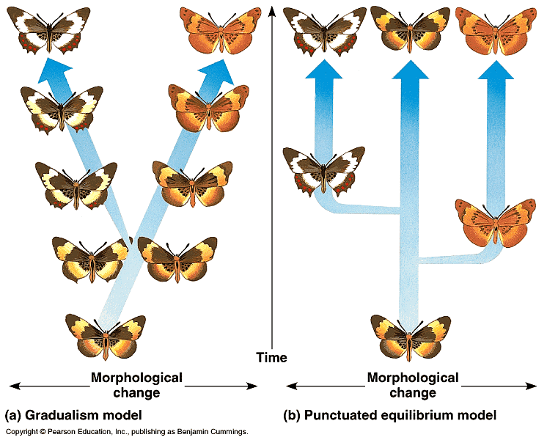

Slide 10
variation
Microevolution- focuses on the genetics
Three causes of variation
1. mutation- random changes
2. recombination- shuffling of genes
3. random pairing of gametes

Slide 11
Hardy-Weinberg genetic equilibrium
Five assumptions about an ideal population
1. no net mutations, the alleles remain the same
2. no immigration or emigration
3. population is large
4. individuals mate randomly
5. selection does not occur
Allows to predict allele frequency

Slide 12
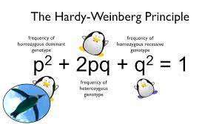

Slide 13
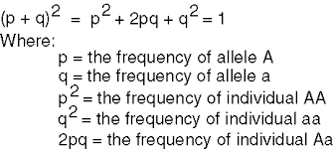

Slide 14
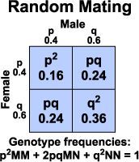

Slide 15
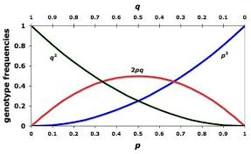

Slide 16
Changes in allele frequency
1. mutation- random change in the DNA sequence
2. gene flow- genes moving from population to population, esp. by migrations and large gatherings
3. genetic drift- allele frequencies change by chance, esp. in small populations
4. nonrandom mating- finding a mate with geographic proximity, usu. Means some distant kinship
5. sexual selection- choosing a mate based on a trait

Slide 17
Genetic drift
Greatly affected by population size
Two types
1. bottleneck- natural disaster leaves small remnant, survivors genes show up more often than normal
2. founder effect- new colony formed, original genes get spread more quickly than normal

Slide 18
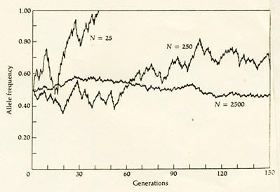

Slide 19
fitness
The ability to pass on one’s genetic information, allowing a specific gene pool to survive

Slide 20
Natural selection
Natural selection acts for increasing successful gene reproducers
Some members of a population are more likely to survive and reproduce
Three types
1. stabilizing- average form of trait has highest fitness
2. disruptive- extreme variations of trait have highest fitness, can be either extreme
3. directional- only one extreme has highest fitness

Slide 21
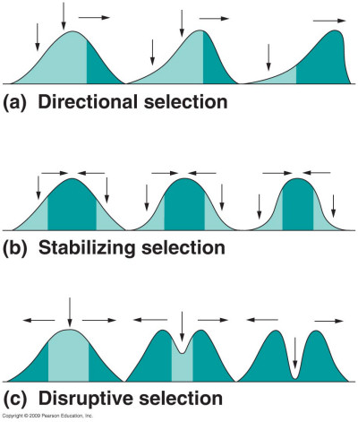

Slide 22
Species
Two types
1. morphological- the structure and appearance is the same
2. biological- can reproduce viable and successively reproducing offspring

Slide 23
Types of speciatation
1. Geographic isolation- physical separation
2. allopatric isolation-usu. Because of a geographic isolation that has been removed
3. reproductive- barriers to selective breeding
4. prezygotic- occurs before fertilization, can be different breeding season or different trait sought
5. postzygotic- occurs after fertilization, usu. Sterile offspring, like mules
6. sympatric speciation- two subpopulations no longer interbreed

