Slide 1
Chapter 9
Mendel and Heredity

Slide 2
Standards
Standard 4- Heredity
CLE 3210.4.3 Predict the outcome of monohybrid and dihybrid crosses.
CLE 3210.4.4 Compare different modes of inheritance: sex linkage, co-dominance, incomplete dominance, multiple alleles, and polygenic traits.
3210.4.2 Complete and interpret genetic problems that illustrate sex linkage, co-dominance, incomplete dominance, multiple alleles, and polygenic inheritance.
3210.4.3 Apply data to complete and interpret a genetic pedigree.
SPI 3210.4.4 Determine the probability of a particular trait in an offspring based on the genotype of the parents and the particular mode of inheritance.
SPI 3210.4.5 Apply pedigree data to interpret various modes of genetic inheritance.

Slide 3
Objectives
Vocab
Punnett squares
Predict ratios and probabilities
Identify types of dominance
Identify types of genetics
Identify two laws

Slide 4
Genetics versus Heredity
Genetics-is the branch of study
Heredity- is how traits are passed from parents to offspring

Slide 5
Father of Genetics
Gregor Mendel created the branch of study (genetics)
Austrian monk that studied pea plants
Created two laws we follow
1. law of segregation
2. law of independent assortment

Slide 6
Pea plants
Had 7 traits Mendel watched
Each trait had only 2 options
1. flower color
2. seed color
3. seed shape
4. pod color
5. pod shape
6. flower position
7. plant height

Slide 7
vocab
P generation- the parents, got by only letting the plants self-pollinate
F1 generation- the children
F2 generation- the grandchildren
F comes from the Latin word Filius meaning son
Or Filia meaning daughter
Monohybrid cross- mating and watching only one trait
True-breeding- a purebred trait

Slide 8
Appearance of traits
Allele- having different versions for the same trait e.g. hair color or eye color
All traits come in pairs of alleles-that means you get two copies
Written as a letter based on the dominant allele, only use one letter for each trait
The dominant allele is capitalized
The recessive allele is lower cased

Slide 9
Allele pairs (come in twos)
Alleles come in pairs, you get two copies (written as two letters)
Homozygous means you get two of the same alleles
Heterozygous means you get two different alleles

Slide 10
Dominant versus recessive
Dominant means it is the expressed allele- it is the one you can see if there are two different ones
Recessive means it is the hidden trait-it is the one you can only see if there are two of the same copies

Slide 11
Dominant versus Recessive
Dominant genetic disorders
If you have one allele, you will have the disorder
Huntington’s disease-brain goes bad
Hypercholesterolemia- high cholesterol
Polydactyl- multiple digits

Slide 12
Dominant versus Recessive
Recessive genetic disorders
You need two alleles to have this disorder
Sickle cell anemia- blood cells are not round
Tay-Sachs- brain goes bad and die early
Cystic fibrosis CF- (65 roses)- produce too much mucous and die early
Hemophilia- blood will not clot, die if get a bad cut

Slide 13
Dominant versus Recessive
Can get gene therapy-replaces the destructive gene
Very expensive
Very painful
Have to take multiple times
Currently used with CF
CF

Slide 14
A Mendelian example
Flower color allele
Can see as purple or white
Written as P for purple and p for white
(one letter for one trait based on the dominant allele-the one seen in a heterozygote)
PP and pp are both homozygous
Pp is heterozygous

Slide 15
Writing the Typing
Using the two alleles
Writing the letters shows the genotype- the actual genes
What the letters stand for shows the phenotype-the physical or visible traits
PP means you have the purple alleles (genotype)
PP means you will see the purple (phenotype)

Slide 16
Two Mendelian laws
1. law of segregation- the two alleles separate when gametes are formed, this is why you get one copy from mom and one copy from dad
2. law of independent assortment- alleles for different genes get separated, this means the seven pea plant traits can be mixed and matched

Slide 17
Punnett Squares
Punnett squares are a visual model for predicting genetic possibilities, it shows all the ways the alleles can be paired
The mathematical possibilities are written as ratios

Slide 18
Punnett Squares
It is a box divided into four equal squares
The P alleles are written on top and down the side of the box, one letter per square on the outside (law of segregation)
The F alleles are written inside the boxes, two letters per box on the inside

Slide 19
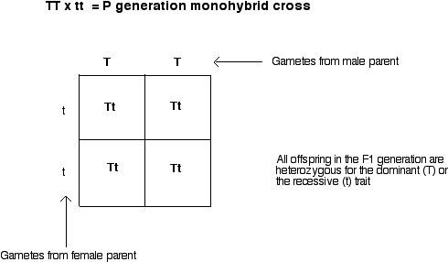
Punnett squares

Slide 20
4 ways to do a monohybrid cross
1. homozygous x homozygous
2. homozygous x heterozygous
3. heterozygous x heterozygous
4. test cross= homozygous recessive x unknown
Look at the offspring to determine the unknown genotype- usually to see if dominant trait is homozygous or heterozygous
All have different and specific genotype and phenotype ratios

Slide 21
1. Monohybrid Punnett Square Ratios
Shows only one trait at a time
The ratios for homozygous dominant and homozygous recessive
Genotype- Pp 4:0
Phenotype- Purple to white 4:0

Slide 22
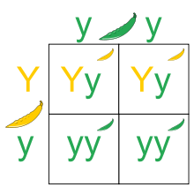
2. Monohybrid Ratios
One heterozygous and one homozygous recessive
Genotype- Pp and pp
Phenotype- purple and white 2:2

Slide 23
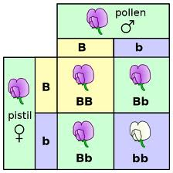
3. Monohybrid Ratios
2 heterozygous parents
Genotype- PP,Pp,pp 1:2:1
Phenotype- Purple to white 3:1

Slide 24
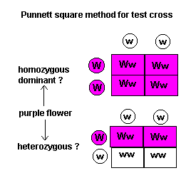
4. Monohybrid Ratio
Test cross
If unknown is homozygous
Genotype is Ww 4:0
Phenotype is purple to white 4:0
If unknown is heterozygous
Genotype is Ww, ww 2:2
Phenotype is purple to white 2:2

Slide 25
Punnett Square uses
Probability-the chances of a specific outcome occurring
Test cross-using a homozygous recessive parent and an unknown dominant parent to determine if it is homozygous or heterozygous, based on the ratios

Slide 26
Dihybrid crosses
Looking at two traits at a time
Each outside box gets two letters
Use foil to get all the pairs
Each inside box gets four letters
If two heterozygous parents are used, the phenotypic ratio will ALWAYS be 9:3:3:1

Slide 27
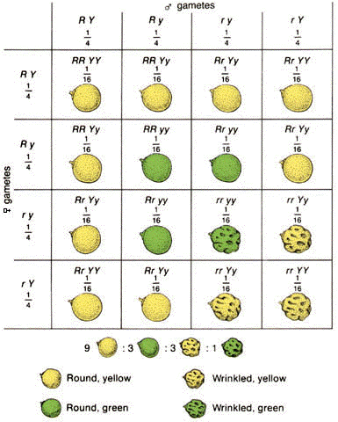
Dihybrid cross

Slide 28
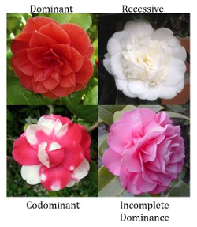
But it is not that easy

Slide 29
3 types of dominance
There are three types of dominance
Based on the phenotype of the heterozygote
1. complete dominance (Mendelian or classical)- see the dominant trait
2. codominance- see both traits at the same time–purple and white
3. incomplete dominance (blending)- see both traits mixed together- a light purple

Slide 30
Five types of genetics
1. Genetics- normal inheritance
2. Polygenetics-several genes are used for one trait
3. Epigenetics-going above genetics into history and chemistry
4. Sex-linked genetics- allele is only on the X or Y chromosome
5. Pleiotropy- one gene controls multiple traits

Slide 31
Pedigrees
A visual chart of inheritance
Males are made as squares
Females are made as circles
If you are affected, the box is filled in
If you are not affected, the box is left open

Slide 32
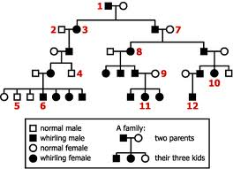
Pedigrees

Slide 33
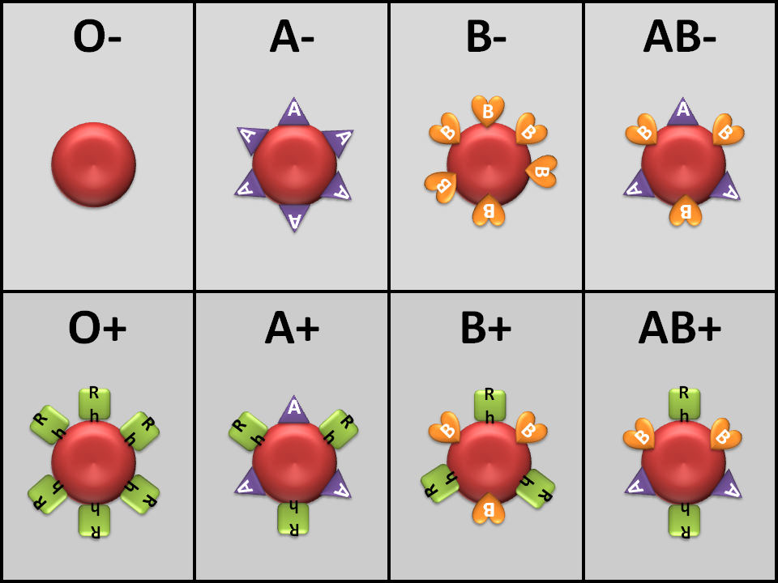
Blood types

Slide 34
Sex-linked traits
Examples:
Hemophilia
Color blindness
Baldness
Duchenne muscular dystrophy

