Slide 1
Ch 22 humans and the environment

Slide 2
Standards
SPI 3210.2.4 Predict how various types of human activities affect the environment.
SPI 3210.2.5 Make inferences about how a specific environmental change can affect the amount of biodiversity.

Slide 3
Objectives
Describe all the good and bad ways humans effect the environment

Slide 4
Environmental science
An AP class you can take junior or senior year
The study of the interaction between humans and their own environment

Slide 5
Earth’s spheres or layers
Geosphere- inner rock layer
Hydrosphere- water layer (only 3% is fresh)
Biosphere- where life is
Atmosphere- the gases that surround Earth

Slide 6
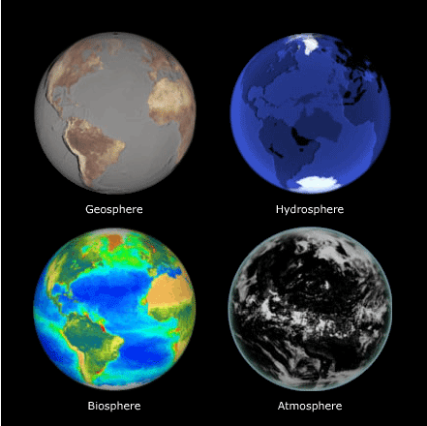
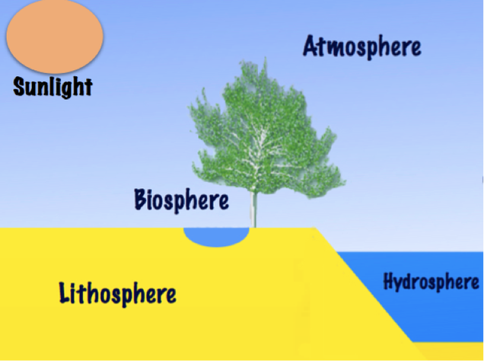

Slide 7
Atmosphere
78 % N₂ (nitride)
21% O₂
1% other gases such as water vapor, carbon dioxide, and trace amounts of others
O₃ called ozone protects us from too much UV radiation
CO₂ creates the greenhouse effect which keeps too much heat near the surface of the planet

Slide 8
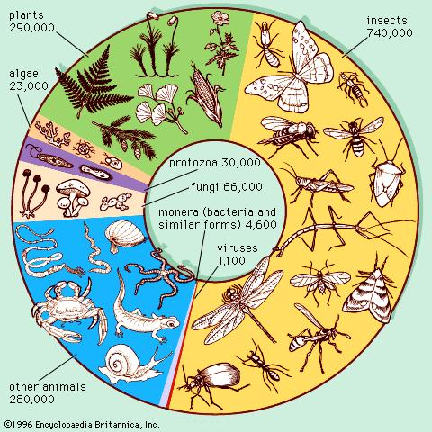
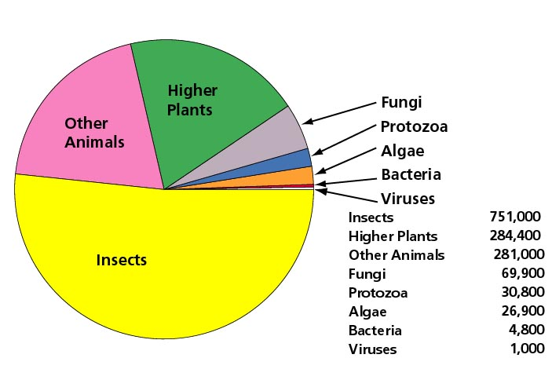
Biodiversity- more is better for resources

Slide 9
Environmental issues
Pollution
Smog
CFCs
DDT
Acid precipitation
Global warming due to more CO₂
Trash
Extinction

Slide 10
Environmental issues
Esp. bad if species are very resource specific
If lose what they need, they cannot adapt and will go extinct

Slide 11
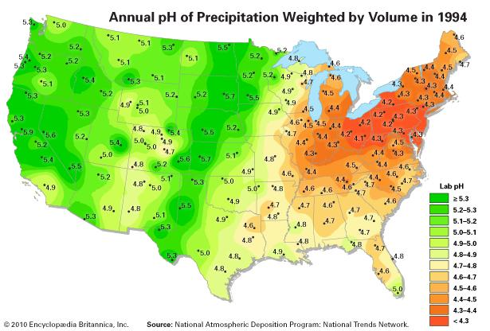
Acid rain in US

Slide 12
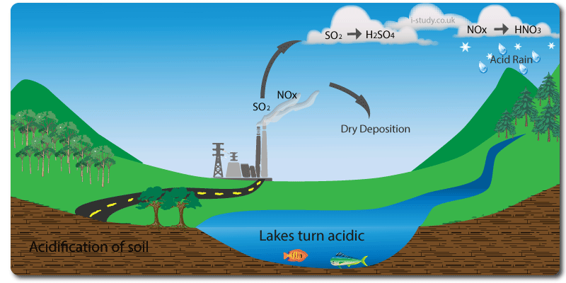
Usu. From factories

Slide 13
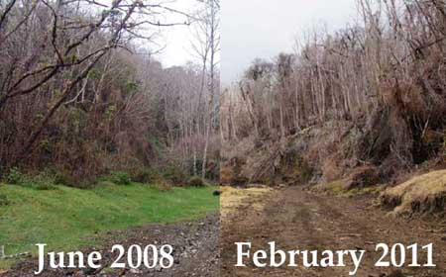
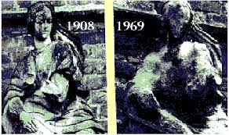
Acid rain effects

Slide 14
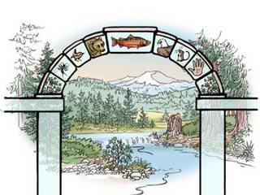
Keystone species- have a major effect
Examples
Sea otter
African elephant
Salmon
Beavers
Coral
Prairie dogs
Sugar maple trees

Slide 15
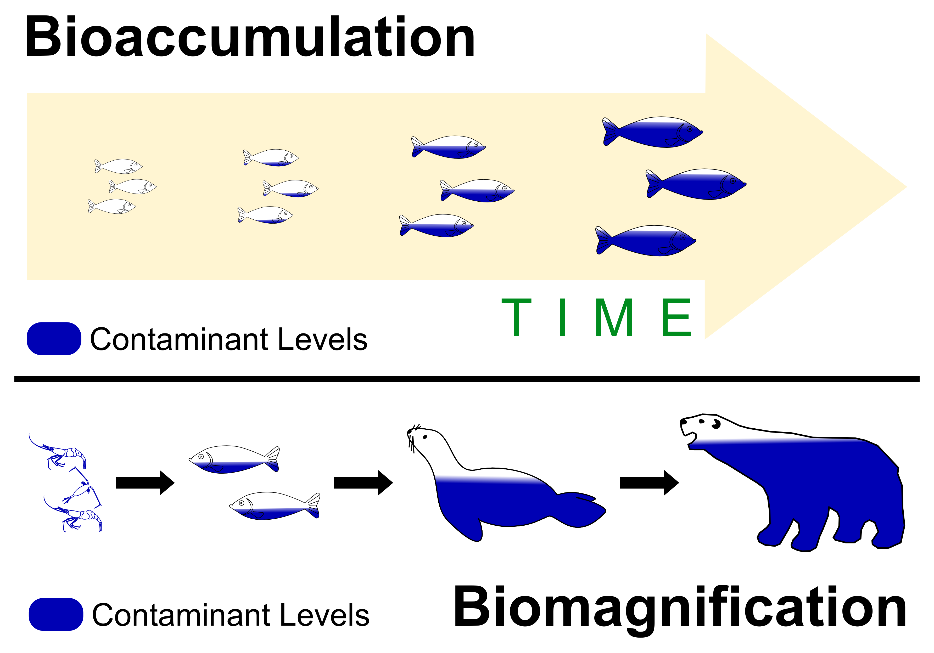

Slide 16
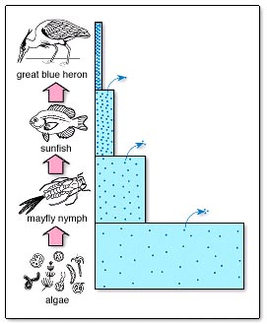
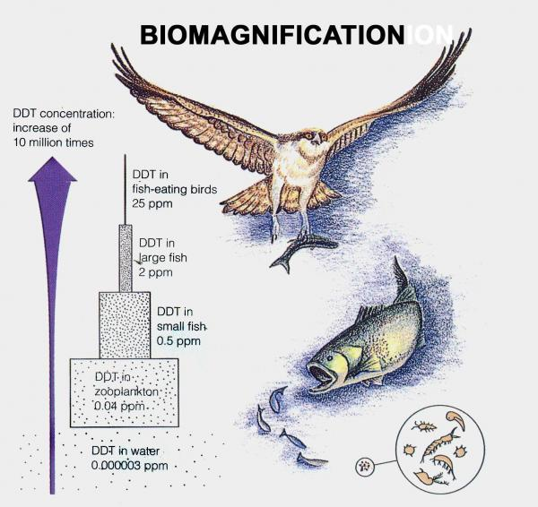

Slide 17
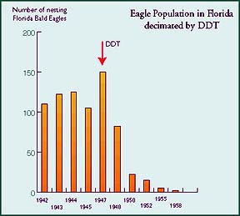
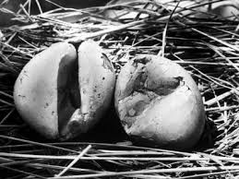
DDT effects

Slide 18
Protecting what is left
Conservation biology- preventing loss, usu. With new laws
Restoration biology- bringing life back to an area
Using a bioindicator (a very sensitive or pH specific species) to test if an environment got fixed

Slide 19
Laws and committees
1872- Creating national parks
1905- Forest service
19676- Clean Air Act
1970- Environment Protection Agency
2005- Kyoto protocol

Slide 20
Support
Ecotourism
Rachel Carson- Silent Spring
Marjory Stoneman Douglas- Everglades Park
Urban ecology- study of biodiversity in densely populated areas of humans

