Slide 1
Ch 21 ecosystems

Slide 2
Standards
SPI 3210.5.1 Compare and contrast the structural, functional, and behavioral adaptations of animals or plants found in different environments.
SPI 3210.5.4 Describe the relationship between the amount of biodiversity and the ability of a population to adapt to a changing environment.
SPI 3210.2.5 Make inferences about how a specific environmental change can affect the amount of biodiversity.

Slide 3
Objectives
Describe the factors of a biome
Differentiate between terrestrial and aquatic biomes

Slide 4
Biomes
Very large climatic regions containing inhabitants that are similarly adapted to the conditions
Based on temperature, precipitation, and soil
2 types
1. terrestrial
2. aquatic
A. freshwater
B. salt water

Slide 5
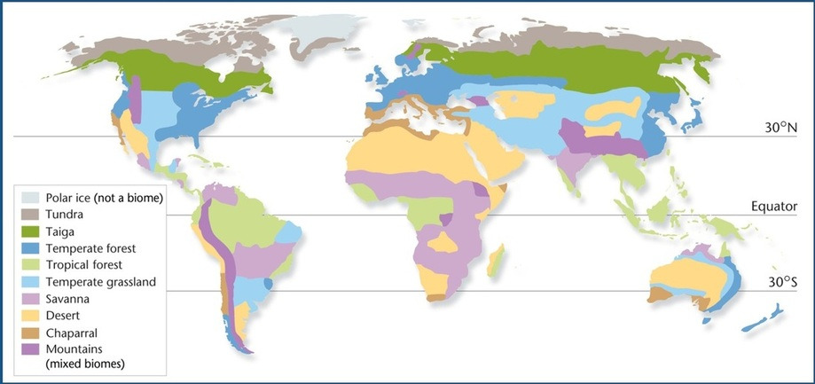
World biomes

Slide 6
Climate is an average
Affected by:
Temperature
Precipitation
Latitude
Altitude

Slide 7
Terrestrial biomes
Tundra
Forests- taiga (boreal), tropical, deciduous, coniferous
Grasslands (prairie, steppe, pampa, veldt)- temperate, savanna, chaparral
Deserts

Slide 8
Tropical
Epiphytes
Epi- on or upon
Phyton- plants
Plants that grow on other plants, but make their own food
What kind of symbiosis is that?

Slide 9
Aquatic biomes
Salt water
Freshwater
Intertidal zone
Neritic zone
Oceanic zone
Estuaries
Lakes and ponds
Rivers and streams
Wetlands-swamps, marshes, bogs

Slide 10
Ocean vocab
Estuary- mix of salt and fresh, used as fish nursery
Neritic-strong currents cause upwellings
Upwelling- lots of nutrients from decaying things on the ocean floor brought to the top
Lots of plankton, so lots of fish

Slide 11
Salt water
Euphotic
Aphotic
Gets enough light
Does photosynthesis
Not enough light
Does chemosynthesis

Slide 12
Fresh water
Eutrophic
Oligotrophic
Good organic matter all over
Murky and difficult to see through
Lots of plants, algae, and bacteria
Bacteria use all the oxygen, so not many animals
Organic matter in low concentrations
Very clear and easy to see through
Lots of bigger animals, esp on the shores

