Slide 1
Ch 20 species interactions

Slide 2
Standards
SPI 3210.2.7 Analyze factors responsible for the changes associated with biological succession.
SPI 3210.5.4 Describe the relationship between the amount of biodiversity and the ability of a population to adapt to a changing environment.

Slide 3
Objectives
5 types of species interactions
Types of adaptations
Species richness
Causes and types of succession

Slide 4
5 types of species interactions
1. predation
2. competition
3. commensalism- symbiosis
4. parasitism- symbiosis
5. mutualism - symbiosis

Slide 5
Adaptations to avoid predation
Mimicry- harmless looks like harmful
Physical defenses- thorns, spines
Chemical defenses- taste bad, irritating, or poisonous (secondary compounds are metabolism byproducts)

Slide 6
2 types of competition
1. interspecies- competing between 2 or more species, usu. For resources
Results in competitive exclusion- one species gets pushed out of the environment b/c the other uses the resources more efficiently
2. intraspecies- competing within the same species, usu. For mates
Results in character displacement- the temperament changes

Slide 7
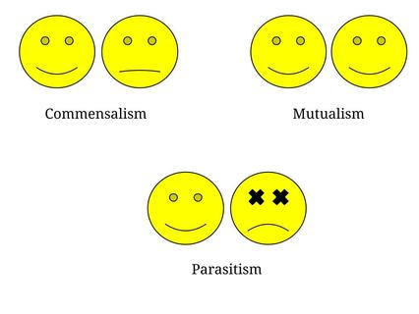
Symbiosis

Slide 8
Species richness
Number of species in the community
Species evenness is the relative abundance
More biodiversity at the equator/rainforest b/c more water
Less biodiversity at the tundra/desert b/c less water
Species-area effect you find more species on bigger islands

Slide 9
Succession
Something disturbs the environment
Pioneer species- the first one that comes back first, usu. Small and grow/reproduce quickly
Climax community- a stable, self-supporting community of species

Slide 10
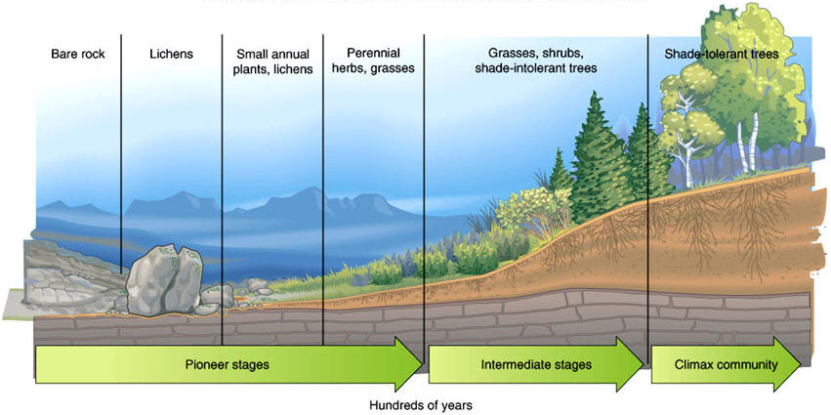
Primary succession- no soil and takes longer

Slide 11
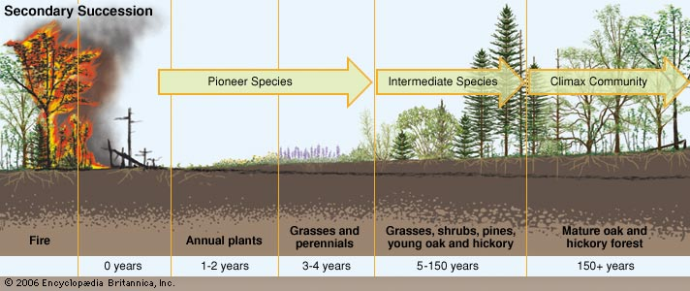
Secondary succession- has soil and returns quicker

