Slide 1
Ch 19 populations

Slide 2
Standards
SPI 3210.5.2 Recognize the relationship between form and function in living things.
SPI 3210.5.3 Recognize the relationships among environmental change, genetic variation, natural selection, and the emergence of a new species.
SPI 3210.5.4 Describe the relationship between the amount of biodiversity and the ability of a population to adapt to a changing environment.

Slide 3
Objectives
3 types of dispersion
Survivorship curves
Density- independent vs density- dependent factors
Invasive species

Slide 5
Population vs species
Species- a population that can interbreed
Population- a group of organisms that belong to the same species and live in a particular places at the same time

Slide 6
Population density- how close/far apart are they

Slide 7
Population distribution, dispersion, density

Slide 8
Population density is a measurement of the number of individuals living in a defined space.

Slide 9
Population dynamics- greatly effected by life expectancy
Growth factors
Shrinking factors
immigration
births
Emigration
Death

Slide 10
Age structure

Slide 11
Strategies
K-strategist
R-strategist
Large size
Long lifespan
Few offspring
Small size
Short lifespan
Many offspring

Slide 12
Survivorship curves

Slide 13
Type 1
Few offspring
Low infant mortality
Parental care given
Most survive to old age
Large mammals including humans

Slide 14
Type 2
Equal chance of living or dying throughout lifetime
Birds, reptiles, small mammals

Slide 15
Type 3
Many offspring
High infant mortality rate
No parental care given
Invertebrates, fish, amphibians, plants

Slide 16
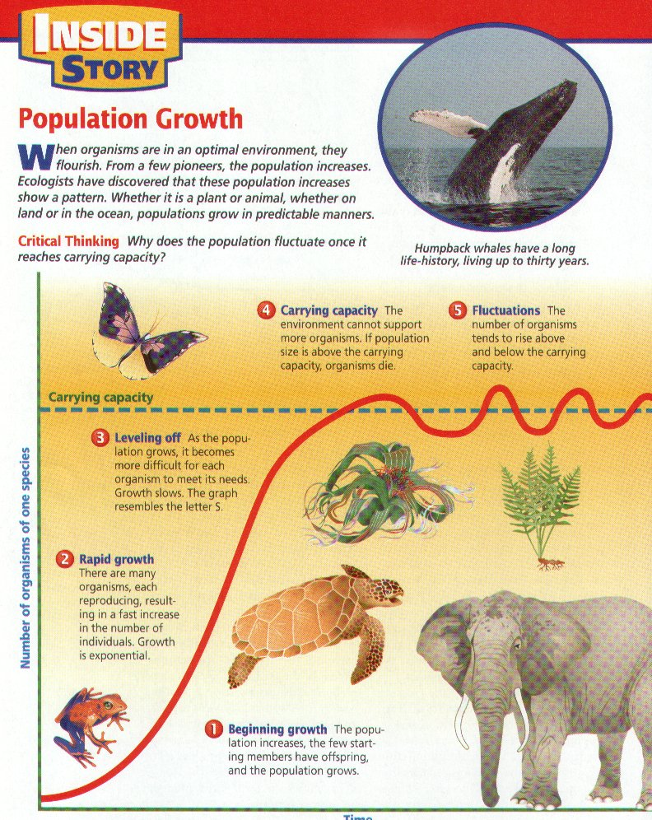
K term – carrying capacity
r term – rate of growth

Slide 17
Exponential curve
Early phase of growth
High availability of resources
Little competition
Little predation

Slide 18
Logistic curve
Limits on growth appear
Competition
Predation
Parasitism
Illness

Slide 19
Carrying capacity
The maximum number of individuals an environment can support

Slide 23
Invasive species
Ones introduced to a new environment
Usu. Do not have predators, so pop goes up
Usu. Can outcompete the native species, so pop goes down

Slide 24
Examples- nutria from South America

Slide 25
Silver carp

Slide 26
Cane toads in Australia

Slide 27
Kudzu in the South

