Slide 1
Bioethics

Slide 2
Standards
CLE 3210.4.7 Assess the scientific and ethical ramifications of emerging genetic technologies.
􀀹3210.4.7 Conduct research to explore the scientific and ethical issues associated with emerging gene technologies.
SPI 3210.4.9 Evaluate the scientific and ethical issues associated with gene technologies: genetic engineering, cloning, transgenic organism production, stem cell research, and DNA fingerprinting.

Slide 3
objectives
1. evaluate if something is beneficial or harmful
2. be able to explain why we need rules for research

Slide 4
Vocab
PCR- polymerase chain reaction- makes fragmented DNA copies
Primers- artificial DNA to initiate replication
Restriction enzymes- bacterial proteins to cut into DNA
Gel electrophoresis- separates DNA segments by size and charge
Recombinant DNA- DNA from multiple sources
Vectors- carriers
Plasmid- rings of DNA from bacteria
Microarray- tool of DNA fragment copies

Slide 5
Genetic engineering
Medicine
Gene therapy
Stronger plants and animals
Vaccines
Disease-resistance
Pest-resistance
Herbicide-resistance in farming

Slide 6
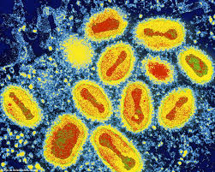
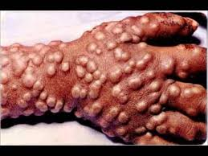
Smallpox

Slide 7
Smallpox
A virus that can be spread by air or contact
Causes a bad rash
Two types- Variola major and Variola minor
Major can kill
Incubation of 12-14 days

Slide 8
1796 smallpox vaccine
A cow had smallpox
A dairy maid got it
Edward Jenner gave cowpox to an eight year old boy, took a week to heal
Edward Jenner gave smallpox to the eight year old boy, never got sick
Tried a couple of times, never got smallpox

Slide 9
1980 smallpox eradication
Last known case in 1980
Vaccine has just about wiped out
No known cure

Slide 10
1928 Penicillin
Alexander Flemming was working on bacteria
Got contaminated with mold
Saw the bacteria did not grow near the mold
Started purifying it
Howard Florey finished purifying it and tested on mice
Tested in 1940 on a policeman, who was sick, it healed him

Slide 11
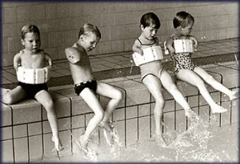
1957 Thalidomide
Created by the Germans as a sedative and morning sickness medicine
Was teratogenic- caused serious mutations in fetuses
Was eventually pulled off the market

Slide 12
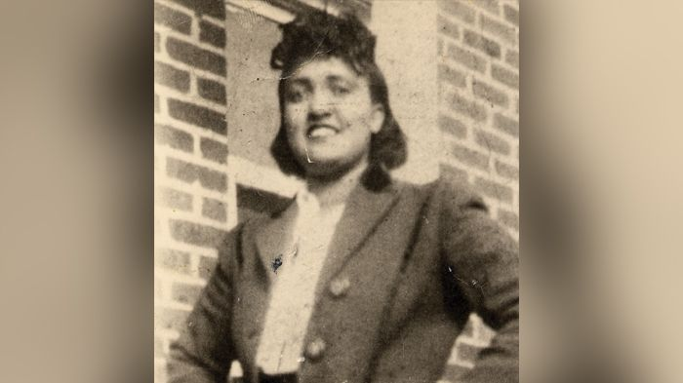
1951 Henrietta Lacks
Had cervical cancer
Went to Johns Hopkins
They took a biopsy
Never gave her a straight answer
Later took biopsies from her children without explaining why
Her cancer cells are still living in lines that are used today

Slide 13
bioethics
The ethics of medical and biological research
Ethics- the moral principles that govern a person’s behavior or the conducting of an activity
So the rules that tell science and medicine who, what, and how they can test something
Especially important in medicine, law, politics, and biotechnology

Slide 14
Bioethics examples
1. Euthanasia
2. Nazi experiments
3. GMO corn and other foods
4. Neuroethics- brain injuries and experiments
5. Cloning
6. Organ donation from human to human
7. Xerotransplantation – organs from animals to humans
8. Stem cell research
9. CRISPR- using technology to change the DNA
10. Henrietta Lacks cancer cells
11. Human research in general
12. Circus shows

Slide 15
Bioethics
Good or bad?

